Slide 1
Global Commerce: 1450-1750
Strayer: Chapter 15

Slide 2
The Big Picture
Europeans and Asian Commerce (Part 1)
Portuguese Empire of Commerce
The East India Companies
Asian Commerce
Silver and Global Commerce (Part 2)
The “World Hunt”: Fur in Global Commerce (Part 3)
Commerce in People: The Atlantic Slave Trade (Part 4)
The Slave Trade in Context
The Slave Trade in Practice
Comparing Consequences: The Impact of the Slave Trade in Africa
Reflections: Economic Globalization- Then and Now (Part 5)

Slide 3
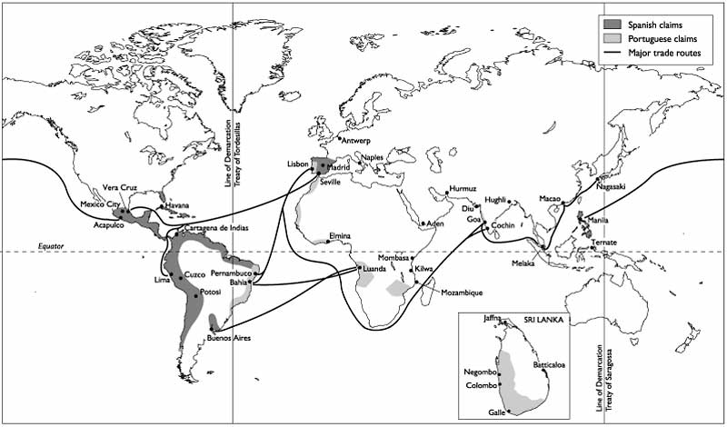
Europeans and Asian Commerce
European control of commerce grows following Columbus (1492) and da Gama (1498)
Europeans encounter rich vibrant trade in Asia and the Americas, but are ignorant of how it works

Slide 4
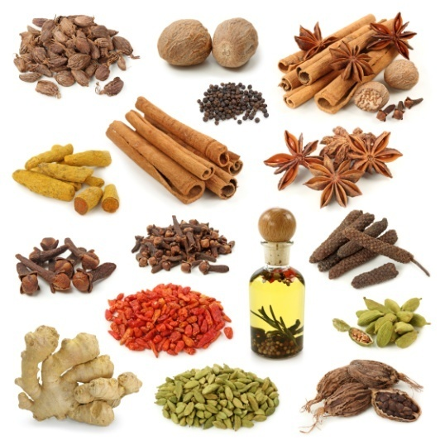
First goal of Europeans = gain access to tropical spices: cinnamon, nutmeg, mace, cloves, and pepper
Other products of interest = Chinese silk, Indian cotton, rhubarb, emeralds, rubies, and sapphires
Controlling trade would allow national monarchies to gain greater access to capital for empire building at home and overseas

Slide 5
Monarchs had political and religious reasons to want to circumvent the trade monopolies held by the Venetians and the Ottoman
Europeans lacked goods desired by Asians, so large quantities of silver and gold were required to bring Asian goods back to Europe
First the Portuguese, then the Spanish, French, Dutch, and British found their way into the Indian Ocean → new regimes and eventually, globalization.

Slide 6
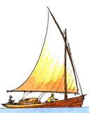
A Portuguese Empire of Commerce
The Portuguese, led by Vasco da Gama, were the first Europeans to reach the Indian Ocean
They joined a vast, diverse, and somewhat disorganized trade network
They had a hard time trading because no one wanted their crude European items…
…Until they learned that most Indian Ocean vessels were not well armed
No regional power controlled trade there

Slide 7
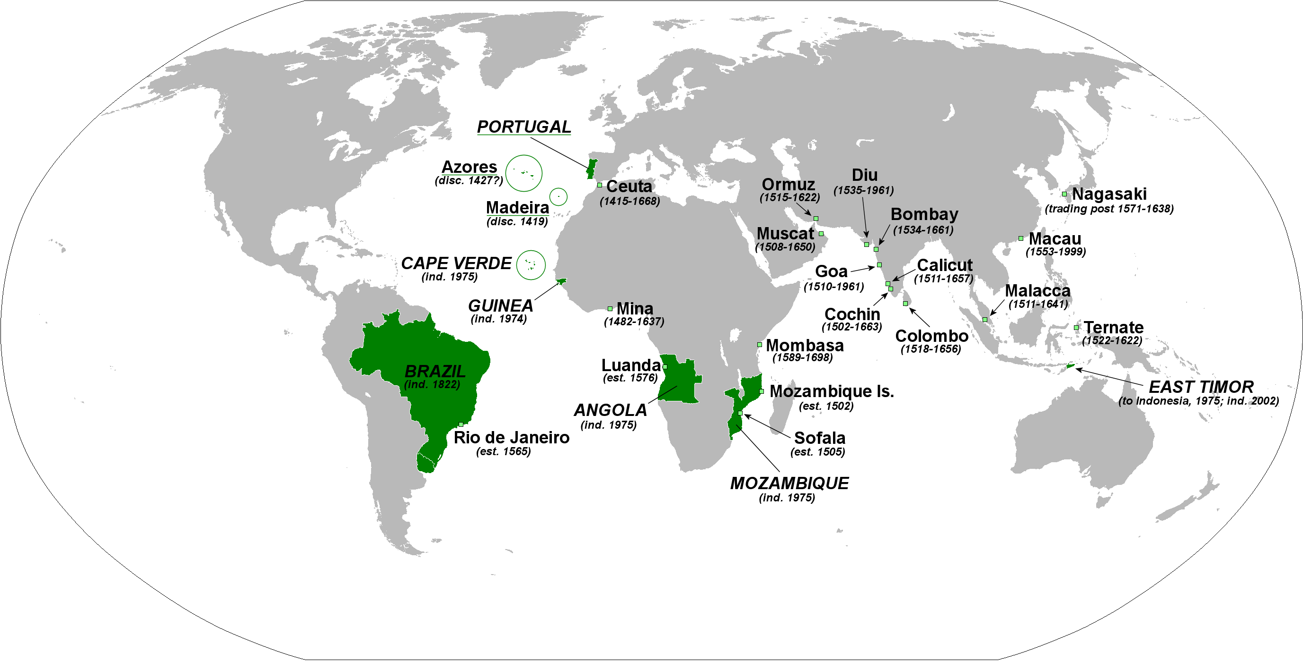
The Portuguese realized their ships could outgun and outmaneuver most ships there, so they set about dominating trade.
The Portuguese began to set up trade fortresses along the coast of the Indian Ocean gaining:
Macao by bribing China
Mombasa
Hormuz
Goa
Malacca

Slide 8
Letter from the King of Mombasa to a neighboring village:
This is to inform you that a great lord has passed through town, burning it and laying waste. He came to the town in such strength and was of such cruelty that he spared neither man nor woman, or old, nor young- nay, not even the smallest child. … Nor can I ascertain nor estimate what wealth they have taken from the town.

Slide 9
Portugal’s goal was to control trade, not build a giant land based empire
Portugal tried to get all local merchants to carry a cartaz, or pass giving them the right to carry out trade in return for a 6% - 10% tax
They also blocked spice boats from Red Sea ports
The only succeeded in controlling half of the spice trade heading into Europe.

Slide 10
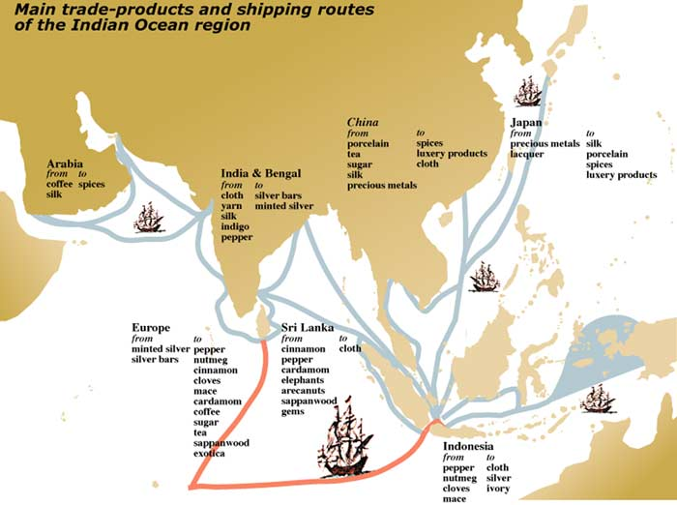
Portuguese trade was in decline by 1600
Portugal was financially and militarily overextended
Could not withstand the challenge of local traders from:
Japan
Burma
Mughal India
Persia
Or European traders from:
Spain
France
England
The Netherlands

Slide 11
Spain and the Philippines
Spain was the first to challenge Portugal’s position of power in the Indian Ocean
They found the Philippines during Magellan’s journey (1519-1521)
Though some places paid tribute to China, most ports were of little interest to the Chinese or Japanese
For Spain, the proximity to China made the Philippines very attractive

Slide 12
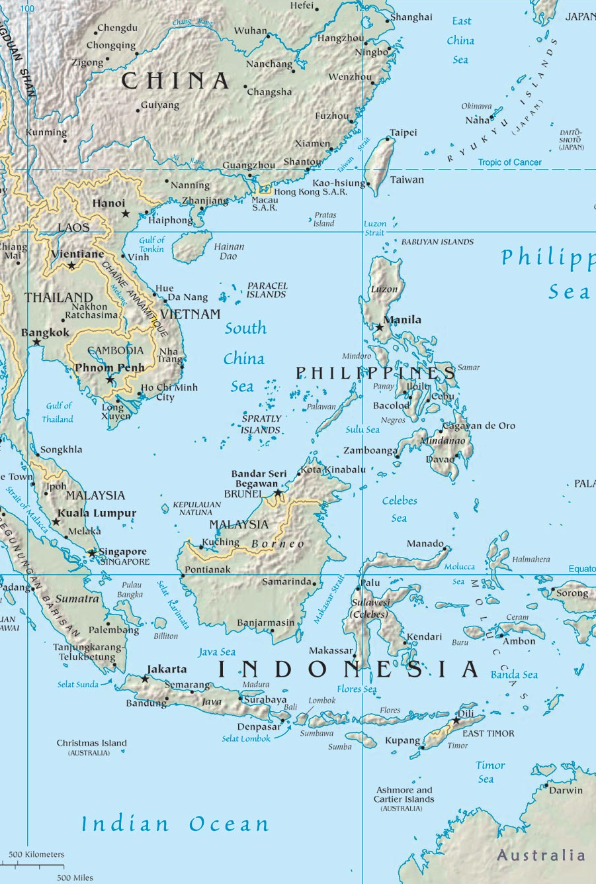
The Spanish decided on outright colonization rather than following the Portuguese model
Spanish rule brought missionaries → establishment of Christianity in the region
Islam, already present in the Philippines, became to form an important part of the ideology of resistance to Spanish rule

Slide 13
Spanish organization in the Philippines was similar to that in the New World
Indigenous people persuaded or forced to relocate to Christian communities
Natives paid taxes, tributes, and mita to Spanish landlords
Large estates were built by Spanish landlords
Women who once had status as healers, midwives, religious leaders, and performers of rituals were replaced by Spanish priests

Slide 14
Short lived revolts erupted against colonial oppression
Many fled to Manila, the capital.
Other groups that came to the capital included Chinese and Japanese merchants
Diversity helped trade flourish, but also led to ethnic tension

Slide 15
The East India Companies
The British and Dutch both entered the Indian Ocean in the early 17th century
Both organized joint-stock trading companies
Corporations or partnerships involving two or more people.
Stocks are issued by the company in return for financial contributions
Shareholders are free to transfer their ownership by selling their stockholding to others.
Benefit: offers the protection of limited liability against the company's debt

Slide 16
Dutch and British traders replaced Portuguese by force, even as they traded with each other
Both were
Militarily and economically stronger
Highly commercialized and urbanized
Skilled in new business models
Skilled in new maritime techniques and technology
Had joint-stock companies chartered by their kingdoms that raised money and organized expeditions more efficiently

Slide 17
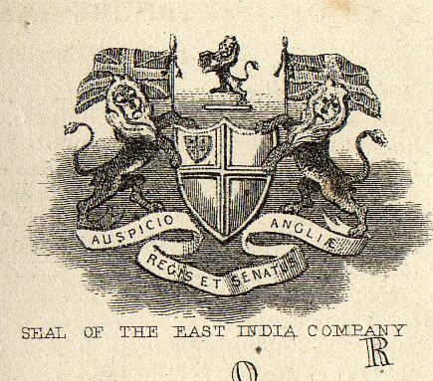
The Dutch focused on Indonesia
The British focused on India
The French arrived later, and clashed with the British in southern India

Slide 18
The Dutch focused on controlling trade and production of: cloves, cinnamon, mace, and nutmeg by claiming control of many small islands (see Java in your textbooks!)
They set up monopolies
Burned the crops of people who refused to trade with them
Brought in slaves to grow nutmeg after killing the inhabitants of the Banda Islands
Dutch profits soared as local economies were shattered

Slide 19
The British who were less organized than the Dutch were largely excluded from the Spice Islands so they focused on India instead
Established three major trading centers: Bombay, Calcutta, and Madras
Not strong enough to overrun the Mughals in India as the Dutch had with the Spice Islands = no trade by warfare
Signed trade agreements with local leaders
Began to focus heavily on cotton trade

Slide 20
British and Dutch trade in the Indian Ocean provided many benefits for their countries
Able to buy Asian goods by trading spices and cotton rather than silver and gold
Began to trade in bulk goods (paper, cotton, pepper) instead of luxury items (silk, porcelain)
As time passed, both turned trading ports into more typical colonies

Slide 21
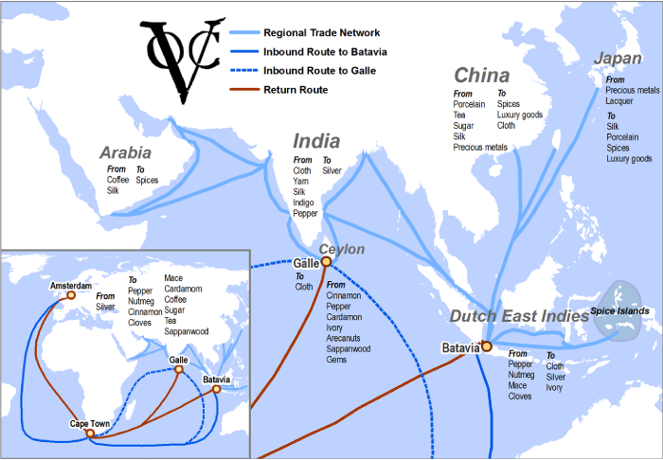
Asian Commerce
Even though Europeans were beginning to control trade, powerful empires continued to exist in Mughal India, Ming China, and Tokugawa Japan
Arab, Javanese, Malay, and Chinese (not state sponsored) traders continued to trade and benefitted from interaction with Europeans
Asians continued to control overland trade routes like the Silk Road

Slide 22
Japan and Trade
European merchants and missionaries first arrived in the mid-16th century
Japanese warlords bought firearms to fuel their civil wars
The Tokugawa used Portuguese guns to defeat their enemies and create a strong shogunate, then ejected foreigners and attempted to isolate their Island nation

Slide 23
Questions
What drove European involvement in the world of Asian commerce?
To what extent did the Portuguese realize their own goals in the Indian Ocean?
How did the Portuguese, Spanish, Dutch, and British initiatives in Asia differ from one another?
To what extent did the British and Dutch trading companies change the societies they encountered in Asia?
In what specific ways did trade foster trade in the early modern era?
To what extent did Europeans transform earlier patterns of commerce, and in what ways did they assimilate those older patterns?
Describe and account for the differing outcomes of European expansion in the Americas, Africa and Asia.

Slide 24
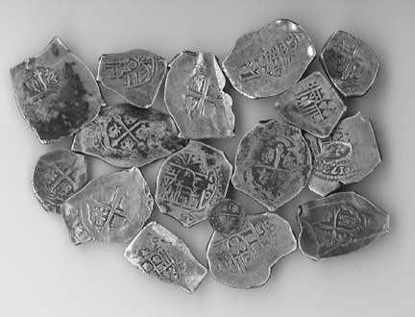
The Silver Trade
Silver makes the world go round

Slide 25
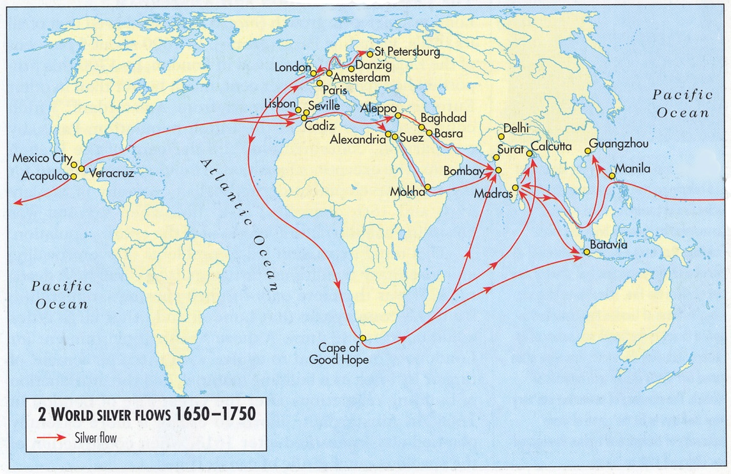
Silver and Global Commerce
The demand for silver in China and Japan, plus the discovery of silver mines in South America led to the emergence of a global exchange network

Slide 26
Silver “went round the world and made the world go round.”
Mid 16th century, large deposits of silver found in Bolivia and Japan vastly increasing silver in circulation
Spain produced 85% of the world’s silver
Silver was mined in Bolivia, shipped to Acapulco, then entered trade in the Pacific and Philippines connecting Asia and the Americas

Slide 27
China becomes the heart of the silver trade
China produced many goods in high demand around the world
The Chinese government began collecting taxes in silver in 1570 increasing its demand and value
The demand for silver in China made it possible for merchants to get Chinese goods at cheaper prices

Slide 28
The Silver Drain
Most European silver wound up in Asia, and did not leave
In 1621, a Portuguese merchant said that silver “wanders throughout all the world… before flocking to China, where it remains as if at its natural center.”

Slide 29
Silver Transforms what it Touches
Potosi, the site of the Bolivian silver mine, became the largest city in the new world by the 1570s
The European elites lived in luxury
Native American workers suffered horrible conditions
Families sometimes held funerals for men drafted to work in the mines
A priest described Potosi as a “portrait of Hell”

Slide 30
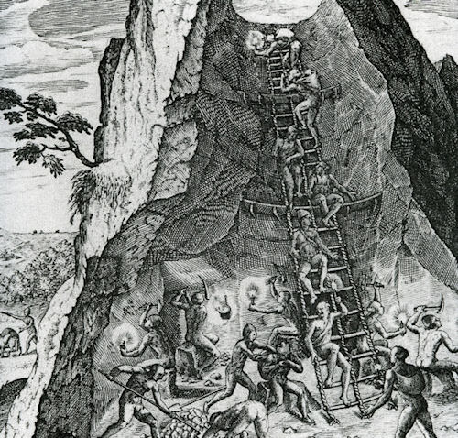
In Spain, silver flooded into the royal treasury making Spain the wealthiest nation in Europe
Instead of changing the Spanish economy, the influx of silver led to massive inflation, but no real economic growth
When silver’s value dropped in the early 17th century, Spain’s economy was devastated!

Slide 31
Japan faired better than Spain when dealing with their influx of silver
The Tokugawa Shogun used silver to build his military and crush rival lords
The shoguns allied with local merchants to invest in agricultural and proto-industrial enterprises
The state worked to preserve forests
Families were encouraged to have fewer children, slowing population growth
By the 19th century, Japan had a thriving commercial economy

Slide 32
China’s growing silver-based economy became the cornerstone of global commerce
By switching to a silver currency, China developed a commercial economy; more and more people began to sell goods to get silver to pay their taxes
The Chinese economy became regionally specific depending on what the goods the geography would support
Forests were destroyed to create more space for growing cash crops

Slide 33
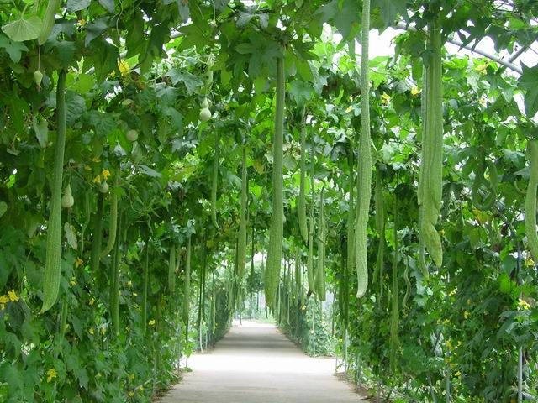
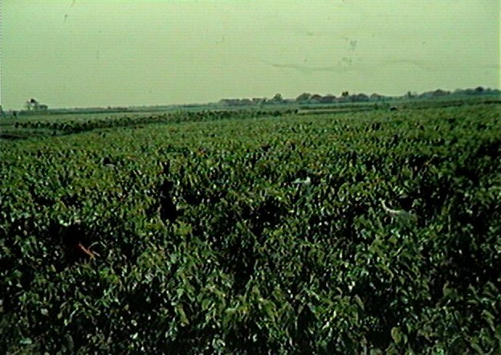
A Poem by Wang Dayue
Rarer, too, their timber grew, and rarer still and rarer
As the hills resembled heads now shave clean of hair.
For the first time, too, moreover they felt an anxious mood
That all their daily logging might not furnish them with fuel.

Slide 34
The Silver Trade
Despite the active role taken by European traders, they were basically middlemen funneling silver from the Americas to Asia
In Spanish America, cheap and well-made Chinese goods outsold Spanish goods
In 1594, the Spanish viceroy in Peru observed that “a man can clothe his wife in Chinese silks for 25 pesos, whereas he could not provide her with clothing of Spanish silks with 200 pesos.”
In Europe, Indian cotton also outsold European wool and linen textiles
In 1717, France passed laws banning the wearing of Chinese silk and Indian cotton to protect local artisans

Slide 35
Questions
How did the silver trade impact each of the following regions?
Spanish America
Spain
Japan
China
What was the world historical importance of the silver trade?

Slide 36
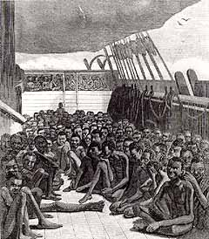
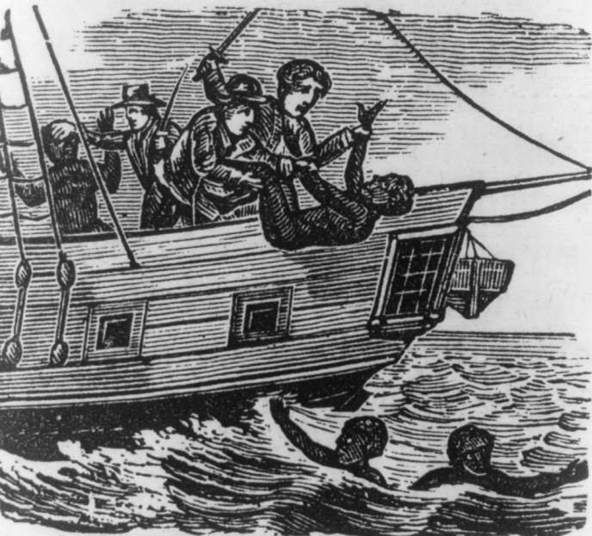
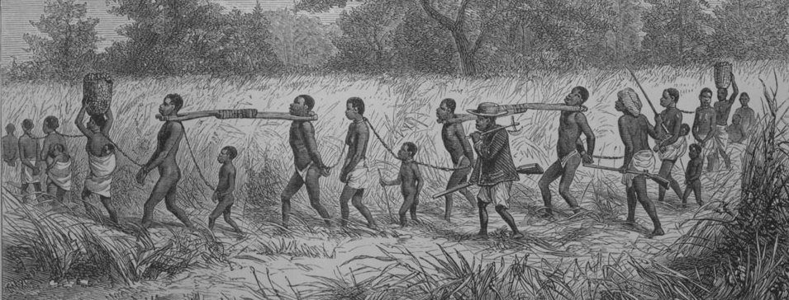
Commerce in People
The Atlantic Slave Trade

Slide 37
Atlantic Slave Trade
Between 1500 and 1866, 12.5 million enslaved people were forcibly relocated from their homes in Africa
10.7 traveled across the Middle Passage and were sold into slavery in the Americas
14.4 %, about 1.8 million died under the horrendous conditions of the crossing

Slide 38
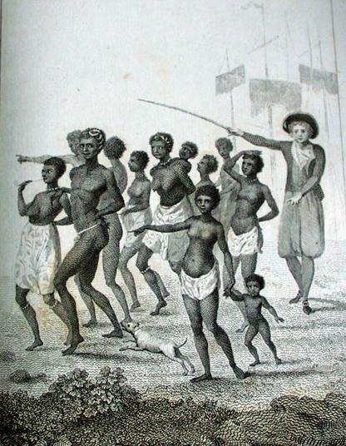
Individual Tragedies
Capture and sale
Displacement from home and culture
Forced labor
Beatings and brandings
Broken families

Slide 39
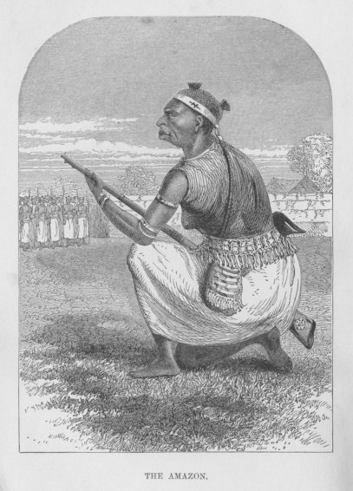
Impact on West Africa
Some societies were thoroughly disrupted
Kingdoms like Ashante and Dahome grew wealthy and powerful from engaging in the gun/slave trade
Leaders grew wealthy and corrupt

Slide 40
Impact in the Americas
Added a substantial African presence to mix with European and Native American peoples
Introduced elements of African culture such as religion, music, and cuisine into the making of the Americas
Use of enslaved Africans shaped early racial prejudices in the Americas
Slavery eventually became a metaphor for social oppression to be used later by labor groups, socialists, feminists, etc.

Slide 41
The Slave Trade in Context
Represents the largest and most recent example of the owning and exchange of human beings ever in history
Before 1500, slave trades existed around the Mediterranean, across the Sahara, in southern Russia, and the Indian Ocean
The trans-Saharan slave trade funneled captive Africans to the Mediterranean, East Africa, Middle East, and Indian Ocean
Existed as part of the Muslim dominated trade in those areas

Slide 42
Treatment of Slaves In the Old World
Slaves were usually outsiders to their “masters’” society
Slaves were often assimilated into their owners’ households, lineages, and communities
Sometimes children of slaves inherited their slave status, other times they were born free
Women made up 2/3 of slaves in the Middle East working mostly as domestic servants
Sometimes slaves worked themselves into positions of power and importance, like Janissaries in the Ottoman Empire

Slide 43
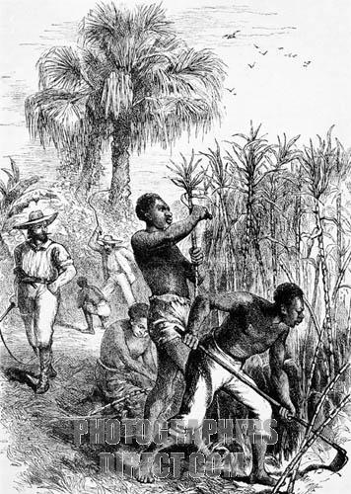
Slavery in the Americas
Differed from Old World slavery in many ways
Involved huge numbers of enslaved peoples
Focused mainly on young men to work on plantations
Enslaved people treated as dehumanized property
Slaves had no rights
Slave status was always inherited
There was little hope of gaining freedom
Became identified with “blackness” and race

Slide 44
Origins of Atlantic Slavery
Related to emergence of sugar plantation in the Mediterranean after Crusaders brought sugar back from the Middle East
European sugar plantations in the Mediterranean and off the coast of Africa became the first modern-style industry to develop in Europe and required
Huge amounts of capital for investment
Disciplined labor force
Mass market of consumers
But presented the following problems
Harsh and difficult work
Limits associated with serfdom
Absence of wage laborers
Slaves became the labor solution

Slide 45
Most Mediterranean slaves came from Slavic regions of the Black Sea. The word slave is derived from Slav
1453 Ottoman conquest of Constantinople cut off this trade
Portuguese traders in West Africa inserted themselves into the pre-existing trans-Saharan slave trade and began selling enslaved Africans to Mediterranean and Atlantic sugar plantations
Once plantations were established in the Americas, the trade simply expanded.

Slide 46
Why Africans?
Slavs were no longer available
Native Americans were dying rapidly from European diseases
European Christians were supposedly “exempt” from slavery
European indentured servants were expensive and temporary
Africans
Were skilled farmers
Had strong immune systems
Were not Christians
Geographically convenient
Available as part of pre-existing commercial networks
Were visibly distinct from white Europeans

Slide 47
Cultural Impact of the Slave Trade
Emergence of negative racial stereotypes
Controversial historical interpretation:
David Brion Davis suggests racial stereotypes were transmitted to Europeans from the Muslim world
Ibn Khaldun a 14th century Tunisian scholar wrote that black people were “submissive to slavery, because Negroes have little that is essentially human and have attributes that are similar to dumb animals”

Slide 48
Other scholars find the roots of racism in European history
Following the English conquest of Ireland, the Irish were described as “rude, beastly, ignorant, cruel, and unruly infidels”
Similar descriptions will be applied to enslaved Africans in the Americas later
Slavery and Racism soon went hand in hand. In 2003, historian Kevin Reilly wrote, “Europeans were better able to tolerate their brutal exploitation of Africans, by imagining that these Africans were an inferior race, or better still, not even human.”

Slide 49
The Slave Trade in Practice
In the Atlantic this trade was dominated by Europeans
In Africa, Africans controlled the trade to meet European demand
Europeans could not penetrate the interior of Africa due to the diseases. Slaves were brought to European fortresses on the coast
Europeans exploited African rivalries and funneled firearms into Africa to further their own profits
The slave trade was only a small part of the Atlantic slave economy and did not constitute a high level of profits like sugar did

Slide 50
In return for slaves, African sellers bought
Guns and gunpowder
European and Indian textiles
Various decorative items like beads
Europeans used American silver to buy the Indian textiles sold to African traders connecting Africa into the global silver exchange

Slide 51
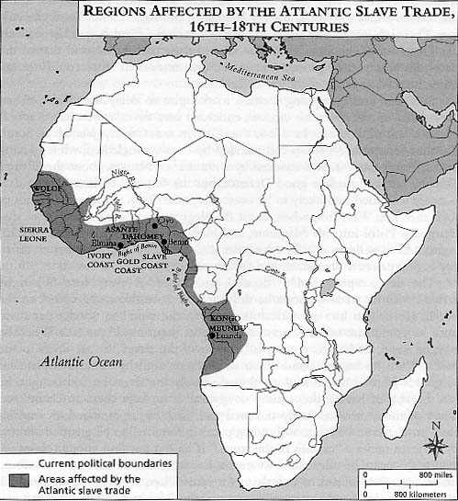
Where Did Enslaved Africans come from?
Mainly from western coast of Africa
From modern day Mauritania to Angola
Made up of
Prisoners of war
Criminals
Debtors
People “pawned” to reduce poverty.
Africans generally did not sell “their own” people

Slide 52
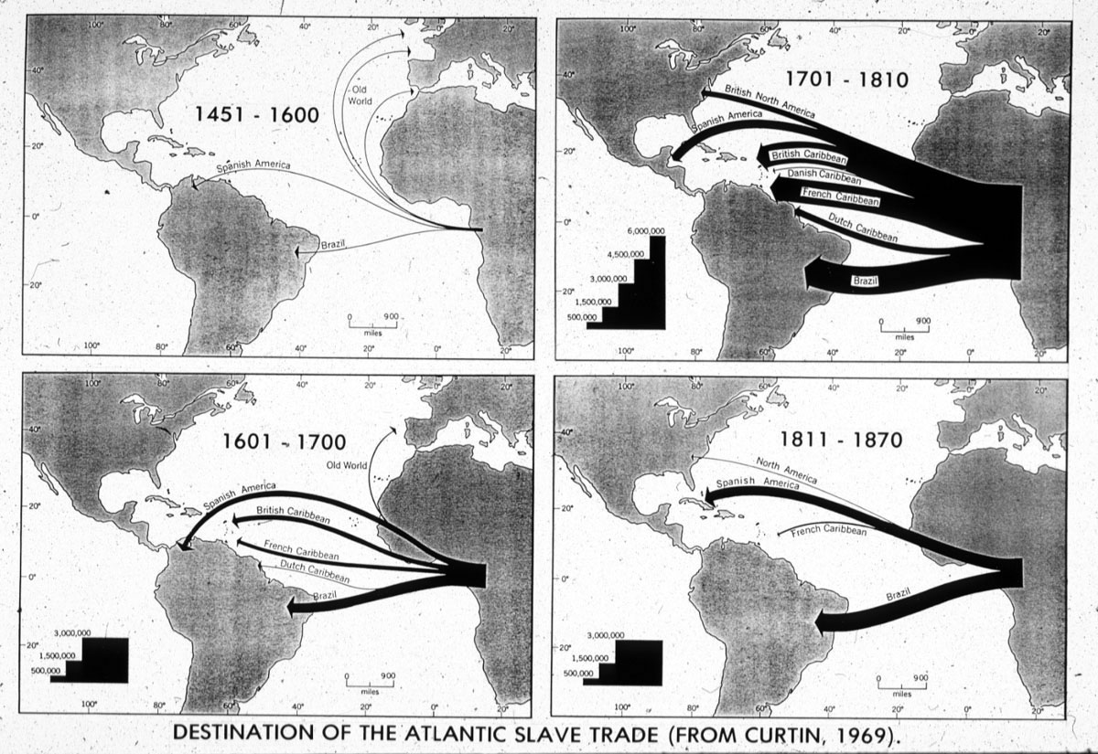
Where Did Enslaved Africans Go?
45% went to Brazil
45% went to the Caribbean
4% went to mainland North America
6% went to Spanish mainland South America
The Middle Passage had a 14% mortality rate
About 10% of transatlantic voyages experienced major rebellions

Slide 53
Comparing Consequences
Africa became a permanent part of the interacting Atlantic World
West African economies were increasing dependent on European trade
Millions of people were forced to make the Americas their home
Slowed the growth of West African populations at a time when Europe and China were experiencing rapid growth
Related to both the slave trade and also the wars and corruption generated by it

Slide 54
Stimulated little positive change in Africa because those who benefitted did not invest in developing their economies
New World crops were introduced, but the economic demand remained focused on people, not production
Small communities were victim to frequent raids, and many collapsed
Benin seriously attempted to limit its role in the slave trade
When Dahome was unable to restrict its involvement in the slave trade, it became a vigorous participant
Used European firearms to build a strong army
Used army to conduct annual raids
The slave trade became the chief economic activity of Dahome

Slide 55
Questions
What was distinctive about the Atlantic slave trade?
What did the Atlantic slave trade share with other patterns of slave trading and slave owning?
What factors explain the rise of the Atlantic slave trade?
What roles did Europeans and Africans each play in the unfolding of the Atlantic slave trade?
In what different ways did the Atlantic slave trade transform African societies?
How should we dispute the moral responsibility for the Atlantic slave trade? Is this a task appropriate for historians?

