Slide 1
Title I Annual Meeting
School-Wide Specialist Presentation
Fall 2022

Slide 2
Wilson’s School-Wide Specialists
Mrs. Teresa Baker tbaker@eriesd.org
Mrs. Julie Mennow jmennow@eriesd.org
We work across grades with the students of Wilson under Title I, a federal grant that ensures that all children have a fair, equal and significant opportunity to obtain a high-quality education and reach, at a minimum, proficiency on academic achievement standards.
We know that families need support with their students learning both at school and at home and our role is to be one more contact point for everyone involved.

Slide 3
Your Rights as Title I Families
Under The Every Student Succeeds Act (ESSA), you are entitled to learn more about your child’s teachers’ training and credentials as well as if your child is being taught by a non-Pennsylvania certified teacher.
We can provide interpreters to families whose primary language is not English and can translate documents as requested
Parents are also encouraged to suggest professional development topics for teachers and to be involved in the revising and editing of the school’s School-Wide Program Plan.

Slide 4
EPS Family Engagement Policy and Funding
Federal Programs / Title I Parent Involvement Policy
This plan can be found at eriesd.org ->Departments ->Federal Programs.
Families are encouraged to work with the Title I teachers in their child’s school on the spending decisions regarding the 1% of Title I funds reserved for family engagement activities.
Please email either School-Wide Specialist if you have ideas to share.

Slide 5
Home-School Learning Compact
As part of our Family Engagement Policy, we have created a Home-School Learning Compact which identifies the responsibilities of the student, the family, and the teacher in the teaching and learning process.
Copies are available for review upon request and can be translated to the primary language of an non-English speaking student and his or her family.
Families are invited to offer suggestions for changes to this document by emailing tbaker@eriesd.org or jmennow@eriesd.org

Slide 6
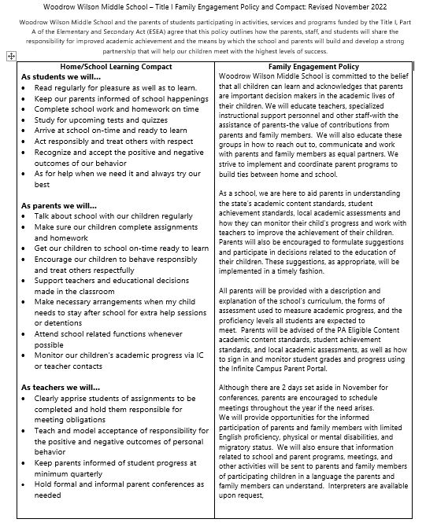

Slide 7
School-wide Plan
This plan takes in to account information on the academic achievement of our students in relation to the State’s academic standards.
The plan includes strategies that will be implemented to strengthen Wilson’s academic programs, increase the amount and quality of learning time, and provide an enriched curriculum
The strategies will address the needs of all children, but those especially at risk of not meeting the State’s challenging academic standards.
A copy of this plan is available upon request.

Slide 8
Family Engagement at Wilson
We believe that a strong working relationship among students, parents, and teachers must be maintained to ensure a positive educational experience.
​Because we believe in this shared responsibility between the home and the school, a Family Engagement Policy has been jointly developed with parents to outline the agreed upon shared responsibilities of the teachers, students and parents at Woodrow Wilson Middle School to improve student achievement
Parents are invited to offer suggestions for changes to this document by emailing either of the School-Wide Specialists.

Slide 9
Curriculum & Student Achievement Standards
ELA Curriculum- HMH Into Literature
Math Curriculum- iReady
Curriculum information and resources are located on the ESD Website:
Curriculum, Instruction, and Professional Development
All student achievement standards in English, Math, and Science are based on PA Eligible Content:
PSSA and Keystone Eligible Content

Slide 10
Student Assessments
The PSSA Exam is given in the spring to all students-Grades 6-8​ in ELA and Math, and Science for Grade 8 only.
Students scheduled in Algebra I take the Keystone test in the fall​
To measure growth, teachers use a number of tools throughout the year:
Math-iReady Diagnostic
ELA-HMH Growth Measure
Science: CDT

Slide 11
Family Resource Center
Although Wilson does not have a formal parent lending library, we will do what we can to assist parents with specific topics related to their student’s educational needs.
If parents have a special request or need information on a specific topic, please contact one of our Title I School-Wide Support teachers previously listed, or our guidance counselors, Mr. Coletta (boys) or Ms. Peck (girls) at (814) 874-6600.

Slide 12
Needs Assessment Survey
All parents are invited to help create, review, and provide feedback for the improvement of the school’s Title I program by completing a “Needs Assessment Survey.” This survey will also allow parents to provide feedback on parent involvement activities and make suggestions to help guide staff professional development for the upcoming school year. An end-of-year survey will be available in May 2023 to address family needs, evaluate the program and make suggestions for improvement-please follow our Facebook page or check our website for availability.

Slide 13
Contacting Staff
Parents are encouraged to email teachers to maintain contact throughout the year. If parents would like to schedule a conference with their child’s team of teachers, the office may be contacted directly, and arrangements will be made with 24-hour notice.
Parents are also encouraged to learn how to sign in and monitor student grades and progress using the Infinite Campus Parent Portal as well as their child’s Schoology account.
You may also contact tbaker@eriesd.org or jmennow@eriesd.org if you have any questions about anything in this presentation.

Slide 14
Questions and Survey
We are happy to stay and answer any questions you may have.
As you leave, would you please take a minute and complete the short survey you were handed on your way in to help us with future programming for our families-they can be returned to the front table or after your conference

