Slide 1
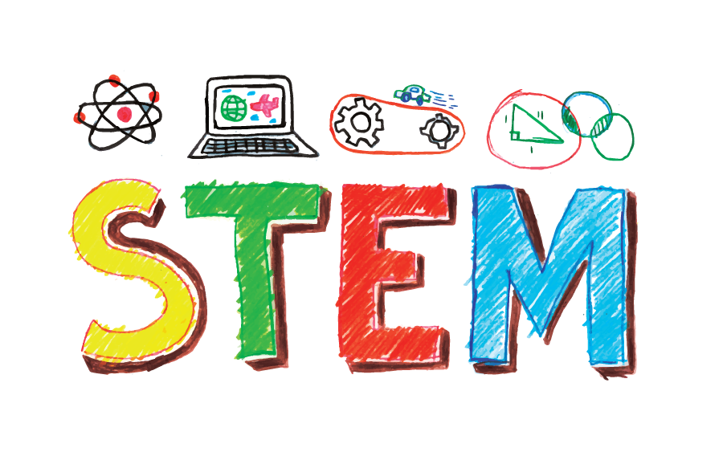
STEM
The Information Guide

Slide 2
So what IS STEM?
STEM stands for Science, Technology, Engineering, and Math but what it really is, is so much more for our children!
STEM is:
-a power to solve problems
-a way to help other people
-a passion for learning
-sharing good ideas
-a way to use technology as a tool

Slide 3
STEM is not a spectator sport...
Everything you do that encourages STEM learning at home, multiplies the STEM learning in our classrooms. STEM is not just what students participate in during my class, STEM is in every class!

Slide 4
Students practice STEM when they….
-solve a math problem using a formula
-discover something new in Science
-read biographies about inventors, engineers, teachers, doctors, scientists, etc.
-use a recipe and measure out ingredients after creating a food budget
-learn about patterns in art class
-use computer programs to create something new

Slide 5
-Continued
-listen to different instruments and then explore how those instruments turn into full scale songs
-do 5 sets of 10 jumping jacks
-code a game
-learn how gravity affects different sports
“The only limit on what kids can do is their imagination.”
~Chris Woods

Slide 6
Kids can do great things, greater than we have done.
How can we help each other?
ENCOURAGEMENT - Kids are very creative. Encourage each other to be creative.
ATTENTION - Ask open ended questions.
TIME - What we do WITH kids is more important that what we do FOR kids.
UNDERSTANDING - Kids are SMART but they have had different experiences that we have and therefore THINK differently.
LIMIT - Limit time on Social Media, it is a vast wasteland robbing our children’s ability to think critically and creatively.

Slide 7
What else?
STEM learning isn’t about what you have but what you DO with what you have.
I don’t give you a list of REQUIRED materials. Instead I’ll tell you to look around, inside and outside, and use the things you can find to create different solutions to a problem. I give suggestions instead.
Kids need to learn with all ten fingers, not just two thumbs and a screen. Technology is definitely more important than ever but technology starts with an idea outside of a screen.

Slide 8
What can we do at home?
-play board games or better yet, make a new board game
-go on walks and notice the shapes, colors, and textures in nature
-use a calculator at the grocery store to find the best prices
-visit an antique shop
-watch a sporting event and keep statistics on your favorite player
-take something apart and put it back together

Slide 9
STEM does not stop at the end of my class.
Everything we do has an aspect of STEM so keep looking for opportunities to learn outside of the classroom. I’ll keep giving you opportunities to learn inside the classroom. Together, we will be a team that helps this generation achieve greatness!

Slide 10
Lastly...
If you have any questions, concerns, comments, or ways to bring your STEM experiences into the classroom, please contact me.
Email: kgodzwa@eriesd.org
I’d love to learn more about how we can work together.

