Slide 1
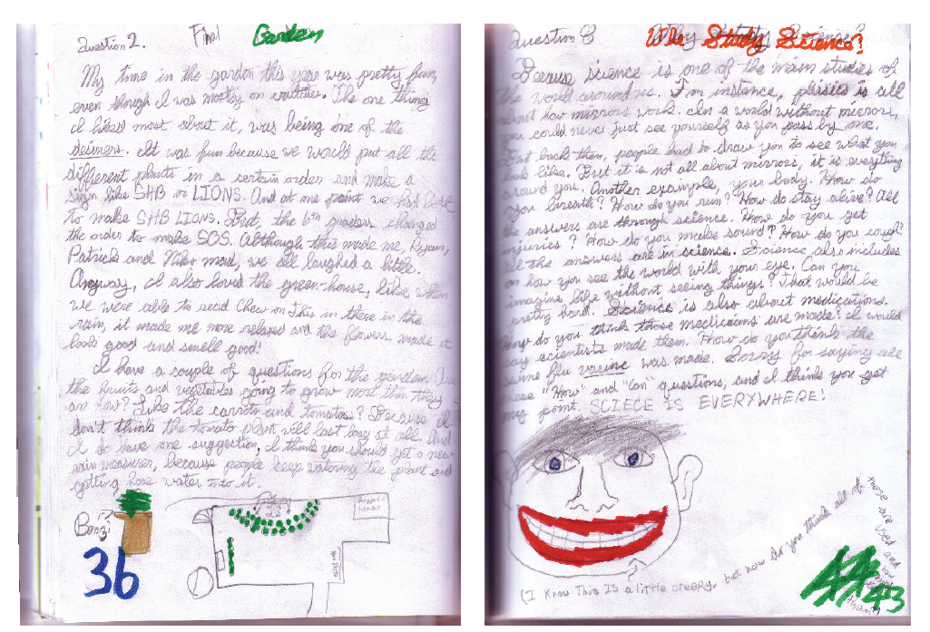
Setting up your Science Notebook

Slide 2
Pair-Share
How have you used a notebook or journal before?
At home…
At school…
How do you think you might use a notebook to do science?

Slide 3
Setting up your notebook
STEP 1: Table of Contents
Glue in 3 Table of Contents pages
Use front and back of notebook pages
STEP 2: Number pages
Skip 2 blank pages
Number all pages in the same location on the page
Continue until you run out of pages!

Slide 4
Three Types of Entries
Investigation
Notes
Reflection
Notes:
After introducing the three types of entries, give students the “Science Notebook Entries Student version” so that they can make notes about falls under each category. Ask students what kinds of things they think might be included in each type of entry, then share information about the category with them.

Slide 5
Setting up your notebook
STEP 3: Three Types of Entries
Glue in the “Science Notebook Entries” key
Use a blank page or the inside front cover
Refer to this page when making new entries and reviewing your notebook!

Slide 6
My first entry: Reflection
Turn to your first empty, numbered page
Add a heading at the top of the page:
Reflection: My new notebook Name Date
Notes:
Could ask students what symbol they think they will use in this heading, if it is a “reflection” entry, before revealing the circle symbol.

Slide 7
My first entry: Reflection
Before writing your reflection, add it to your Table of Contents:
Date | Entry title | Page Number | Symbol

Slide 8
My first entry: Reflection
What is one thing you are looking forward to doing in your science notebook?
I am looking forward to…
What do you still wonder about your science notebook?
I wonder…

