Slide 1
Lesson 26
Percent Composition
Objectives:
- The student will determine percentage composition from formula data.
- The student will determine percentage composition of a hydrated salt.
PA Science and Technology Standards: 3.4.10.A; 3.4.12.A
PA Mathematics Standards: 2.2.11.A, 2.3.11.C, 2.4.11.E, 2.5.11.A

Slide 2
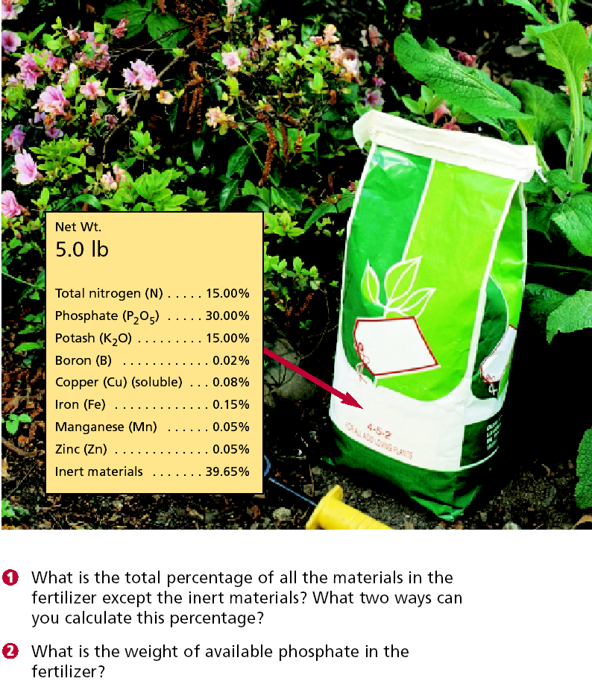

Slide 3
I. Percentage Composition a. If you need to know how much of a particular element you can get from a compound, you can determine percentage composition b. Remember that molar mass is 100% of the mass represented by the formula c. Therefore, the percentage of each element in the compound is the molar mass of the element divided by the molar mass of the compound, times 100%.

Slide 4
d. Example
Copper (I) sulfide is found in nature as the mineral chalcocite, a copper ore. What is the percent composition of pure chalcocite?
1. Determine the compound formula:
Cu⁺¹ and S⁻², when combined, give Cu₂S
2. Determine the molar masses of the elements:
Cu = 63.55 g/mol
S = 32.07 g/mol
3. Determine the molar mass for Cu₂S:
2 Cu X 63.55 g/mol = 127.10 g
1 S X 32.07 g/mol = 32.07 g
Molar mass of Cu₂S 159.17 g

Slide 5
4. Calculate the percent composition for each element in the compound:
Percentage Cu = Mass of 2 Cu 127.10 g Cu
--------------- = --------------- X 100 = Molar mass of Cu₂S 159.17 g Cu₂S
79.850% Cu
Percentage S = Mass of 1 S 32.07 g S
------------------ = --------------- X 100 =
Molar mass of Cu₂S 159.17 g Cu₂S
20.15% S

Slide 6
Check your work!!! – the percentages should add up to no more than 101% and no less than 99% (due to rounding)
79.85% + 20.15% = 100.00%

Slide 7
II. Percentage composition tells how much water is in a hydrate
A. Some salts have the ability to bind water molecules within their lattice structure
B. These salts are known as hydrated crystals
C. The anhydrous forms, or forms without water, have various uses: i. Desiccants (drying agents) ii. Moisture indicators (due to color change)
D. One salt that can form a hydrate is CuSO₄, or copper (II) sulfate i. Copper sulfate binds 5 water molecules into its structure, forming copper sulfate pentahydrate. ii. The formula is written CuSO₄ . 5H₂O iii. It indicates that 5 water molecules are included for each formula unit of the main compound.

Slide 8
E. Another example is sodium carbonate decahydrate, or Na₂CO₃ . 10H₂O.
F. Note that the hydrate contains less of the salt than the anhydrous form, because some of the mass of the compound is water in the hydrate, while all of the mass of the compound is the salt in the anhydrous form.
G. How to determine the percentage composition of hydrates
Example:
What percentage of hydrated sodium carbonate, Na₂CO₃ . 10H₂O, is Na₂CO₃?

Slide 9
1. Determine the molar mass of Na₂CO₃
2 mol Na x 22.99 g/mol = 45.98 g
1 mol C x 12.01 g/mol = 12.01 g
3 mol O x 16.00 g/mol = 48.00 g
Molar mass of Na₂CO₃ = 105.99 g/mol

Slide 10
2. Determine the molar mass of 10 moles of H₂O
20 mol H X 1.01 g/mol = 20.2 g
10 mol O X 16.00 g/mol = 160.0 g
Molar mass of 10H₂O 180.2 g/mol

Slide 11
3. Determine the molar mass for Na₂CO₃ . 10H₂O
105.99 g/mol for 1 mol Na₂CO₃
180.2 g/mol for 10 mol H₂O
________________
286.2 g/mol for Na₂CO₃ . 10H₂O
4. Determine the percentage of Na₂CO₃ in the hydrate
105.99 g/mol Na₂CO₃
---------------------------------- X 100 = 37.03% Na₂CO₃
286.2 g/mol Na₂CO₃ . 10H₂O

Slide 12
Percent Composition
1. If given the chemical formula for the compound:
• First calculate the molecular mass of the entire compound
• Example: H₂0
H 2 x 1.0079 = 2.0158
O 1 x 15.999 = 15.999
18.0148 g/n
• Next divide the mass of each element total by the molecular mass to get the percent composition of each of the elements. Multiply by 100 to get a percent.
• H = 2.0158/ 18.0148 = .111897 x 100 = 11%
O = 15.999/ 18.0148 = .888103 x 100 = 89%

Slide 13
If given experimental data in grams follow the same procedure without calculating the molecular weight. Use the individual masses of each elements as the element totals, and the total mass of all the elements as the molecular mass.
• Example: What is the percent composition of an ore which contains 1.86 grams of aluminum and 1.65 grams of oxygen?
Total = 1.86 + 1.65 = 3.51grams
Al 1.86 / 3.51 = .5299 x 100 = 53.0%
O 1.65/ 3.51 = .4700 x 100 = 47.0%

Slide 14
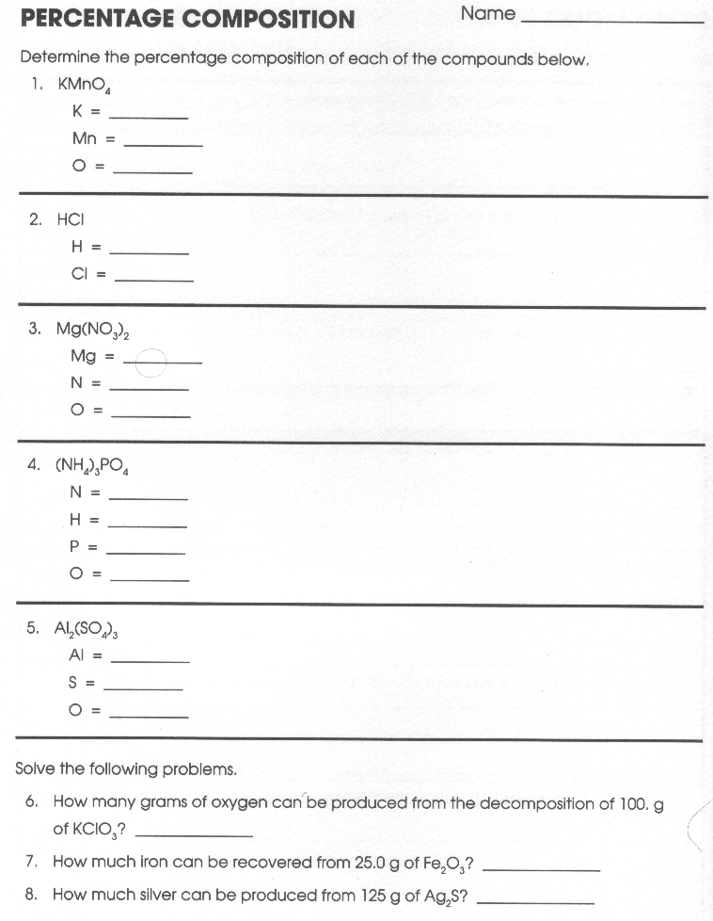
K = 24.74 % Total
Mn = 34.76 % 100.00 %
O = 40.50 %
H = 2.8 % Total
Cl = 97.2 % 100.0 %
O = 39.17 % => 39.2 g
Fe = 70 % => 17.5 g

Slide 15
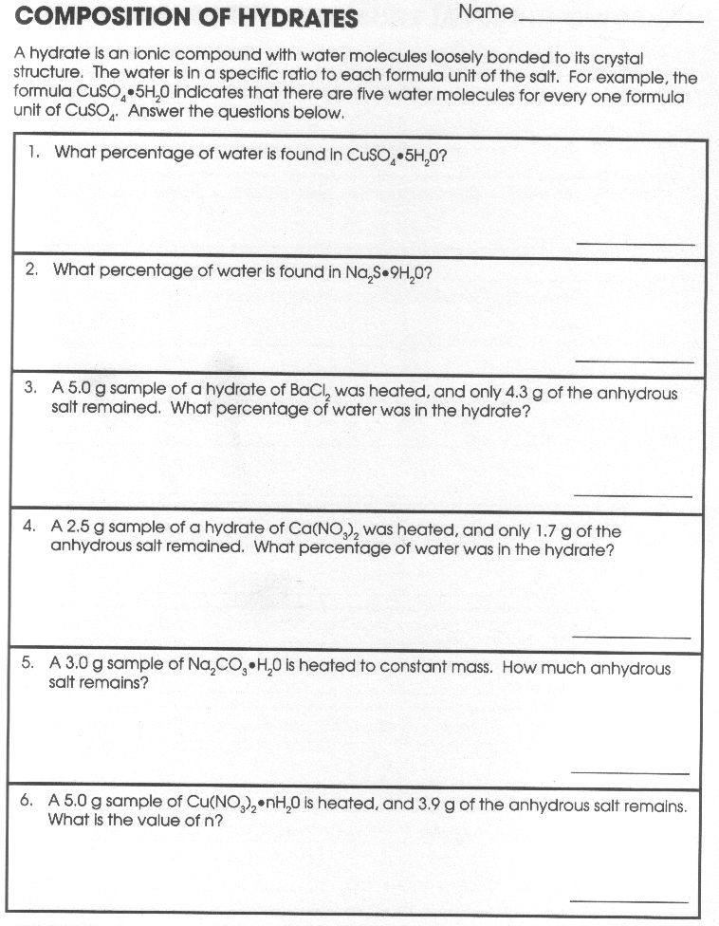

Slide 16
Level 1
Find the percentage composition of each compound listed below. In the first ten problems, the correct formula is given. In the next four problems, laboratory data for the compound are presented.
1. FeO
2. MgCl₂
3. CH₄
4. CS₂
5. NO₂
6. HgO
7. SnI₄
8. Cu₂O
9. NH₃
10. CH₂O

Slide 17
11. What is the percentage composition of an ore which contains 1.86 g of aluminum and 1.65 g of oxygen?
12. A compound of silver contains 4.35 g of that metal combined with 0.65 g of sulfur. What is the percentage composition of this compound?
13. A certain sample of a gas weighing 22.8 g contains 6.22 grams of carbon and an unweighed quantity of oxygen. What is the percentage composition of this gas?
14. A compound consisting of aluminum and chlorine weighs 17.82 g. The aluminum in the compound weighs 3.60 g. What is the weight of chlorine in the compound? What is the percentage composition of the compound?

Slide 18
Level 2
Find the percentage composition of each compound listed below. In the first eight problems, the correct formula or name is given. In the next six problems, laboratory data for the compound are presented.
1. KNO₂
2. NH₄Cl
3. SrCl₂
4. KMnO₄
5. sulfuric acid
6. potassium phosphate
7. ammonium bromide
8. barium hydroxide

Slide 19
9. Analysis of a compound shows that it consists of 43.40 g of copper and 10.95 g of sulfur. What is the percentage composition of this compound?
10. A sample of benzene is analyzed and found to consist of 13.74 grams of carbon and 1.15 grams of hydrogen. What is the percentage composition of benzene?
11. Analysis of an unknown compound shows that it consists of 21.8 g of oxygen, 4.09 g of aluminum, and 6.36 grams of nitrogen. What is the percentage composition of this compound?
12. A compound consisting of carbon, hydrogen, and oxygen weighs 40.85 g. Analysis shows that the compound contains 10.90 g of carbon and 0.90 g of hydrogen. What is the percentage composition of this compound?
13. An organic compound consisting of carbon, hydrogen, and oxygen only weighs 13.669 g. Analysis shows that the compound contains 0.547 g and 8.707 g of the last two of these elements, respectively. What is the percentage composition of this compound?
14. Analysis of an ore of calcium shows it to contain 13.61 g of calcium and 21.77 g of oxygen in a sample weighing 35.38 g. What is the percentage composition of this compound?

Slide 20
Level 3
Find the percentage composition of each compound listed below. In the first eight problems, the correct name is given. In the next six problems, laboratory data for the compound are presented.
1. zinc carbonate
2. ammonium sulfate
3. iron (III) oxide
4. calcium phosphate
5. ammonium dichromate
6. aluminum nitrate
7. calcium acetate
8. ammonium carbonate

Slide 21
9. A sample of water weighing 89.6 g is found to contain 9.98 g of hydrogen. How much oxygen is present in the water? What is the percentage composition of this compound?
10. An organic compound is found to contain 10.18 g of carbon, 1.47 g of hydrogen, and 0.93 g of oxygen. What is the percentage composition of this compound?
11. A sample of organic material weighing 0.005587 g is analyzed and found to contain 2.51 x 10⁻⁴ g of hydrogen and 1.98 x 10⁻³ g of oxygen. What is the percentage composition of this compound?
12. Analysis of 0.005644 g of a compound shows that it contains 4.177 x 10⁻³ g of carbon and 9.76 x 10⁻⁴ g of nitrogen. The hydrogen in the compound cannot be determined directly. What is the percentage composition of this compound?
13. Laboratory analysis of a sample of paraldol shows that it contains 4.67 g of carbon, 0.77 g of hydrogen, and 3.12 g of oxygen. What is the percentage composition of paraldol?
14. An organic compound separated into its elements produces 8.2 g of carbon and 1.44 g of hydrogen from a sample weighing 32.8 g. What is the weight of oxygen in this compound? What is the percentage composition of this compound?

Slide 22
