Slide 1
British Romanticism
Mr. May
January 23rd, 2019

Slide 2
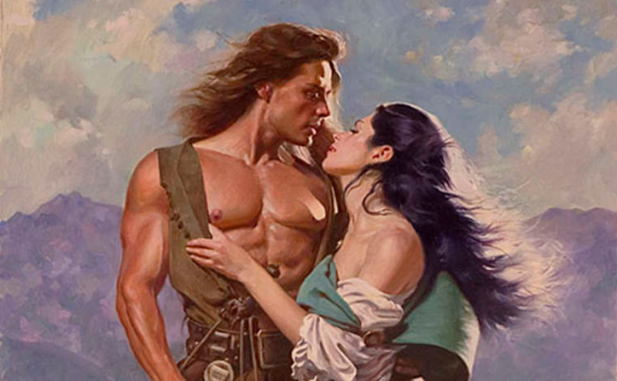
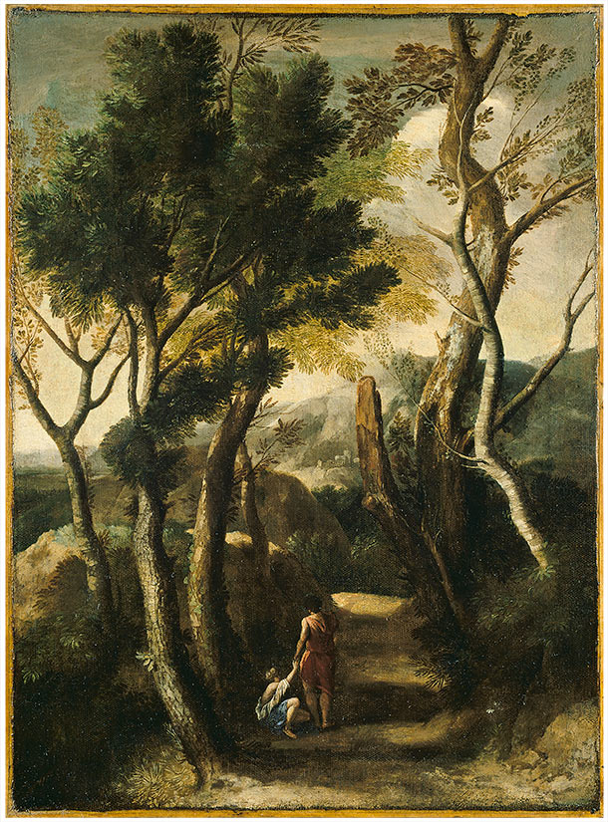
What is Romanticism?
Romanticism has very little to do with what we think of as “romance” today.
Romanticism was a literary
movement that valued nature,
emotion, and the individual,
rather than industry, logic, and
social rules.

Slide 3
A Reactionary Movement
Romanticism was a reaction against what were seen as the negative elements of…
The Industrial Revolution
The Enlightenment
War, violence, and oppression

Slide 4
The Drawbacks of Industry
Pollution
Poverty
Overcrowding
Romantics reacted to all of these problems by protesting against them in their literature and writing positively about rural life and the pre-industrial past.

Slide 5
Romanticism vs. the Enlightenment
Enlightenment
Reason and logic are the most important values.
Art and science help to create progress and reinforce the social order.
Reason can solve all the world’s problems.
Romanticism
Creativity and goodness come from passion, not logic.
Artists are lonely geniuses who are often in conflict with the social order.
There are many things that humans are incapable of understanding.

Slide 6
Tyranny and Revolution
The American and French Revolutions happened in the lead-up to this time period.
Romantics were against monarchs and any government authorities that limited individual freedom.
British Romantics were excited about the French Revolution because they thought it would signal the beginning of real freedom in Europe.
They were wrong. The French Revolution was bloody, violent, and led to the tyranny of Napoleon Bonaparte.
British Romantics became increasingly mistrustful of any kind of war, even for good causes.

Slide 7
Themes of Romanticism
Glorification of an idealized past
The goodness of rural life and people
Connections between emotion, truth, and beauty
Nature as a source of goodness and happiness
The importance of individual freedom

