Slide 1
Electrical/Electronic System Operation and Service
Chapter 22
Notes:
1

Slide 2
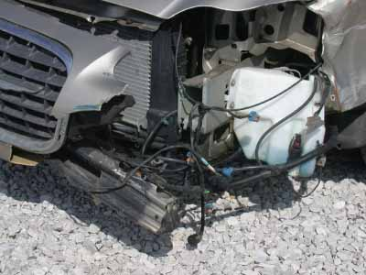
FIGURE 22–10 During a collision, wires can be smashed and shorted. You or a specialized electrical technician must find and correct wiring problems during collision repair.

Slide 3
Objectives
Explain basic electrical values: volts, ohms, and amps
Use Ohm’s Law to calculate circuit values
Describe the difference between series and parallel circuits
Describe the test procedures used to repair electrical and electronic systems
Repair vehicle wiring harnesses damaged during a collision
Notes:
3

Slide 4
Objectives (continued)
Use a scan tool to check for electrical troubles before and after collision repairs
Replace damaged computer system components
Connect and use a multimeter to perform basic electrical tests
Correctly answer ASE-style review questions relating to electrical/electronic systems
Notes:
4

Slide 5
Introduction
Electrical repairs
Repairing severed wiring, replacing engine sensors, scanning for computer or wiring problems, etc.
Collision can easily crush vehicle’s wires and electrical components
Most modern vehicle mechanical systems are monitored or controlled by on-board computers
Notes:
5

Slide 6
Electrical Terminology
Current: movement of electricity (electrons) through a wire or circuit
Direct current (DC)
Alternating current (AC)
Voltage: pressure that pushes electricity through wire or circuit
Resistance: restriction or obstacle to current flow
Conductor: carries current to parts of a circuit

Slide 7
Electrical Terminology (continued)
Ohm’s law
Mathematical formula for calculating an unknown electrical value (amps, volts, or ohms) when two values are known
Magnetism
Study of how electrical fields act on ferrous (iron-containing) objects
Flux or magnetic field
Present around permanent magnets and current-carrying wires

Slide 8
Electrical Terminology (continued)
Electric circuits
Contain a power source, conductors, and a load
Series circuit
Parallel circuit
Series-parallel circuit

Slide 9
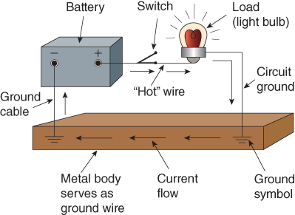
FIGURE 22–3 Most circuits in a car or truck are frame ground circuits. The frame or unibody is used to return electrical current to the battery. This reduces the amount of wires needed to complete circuits. Note ground symbols.

Slide 10
FIGURE 22–4 Compare basic series and parallel circuits. (A) With a series circuit, if one lightbulb or load burns out, the whole circuit will stop working. (B) With a parallel circuit, other legs of the circuit will keep it working if one bulb or load burns out.

Slide 11
Electrical Terminology (continued)
Wiring diagrams, schematics, and trees
Wiring diagram: graphic representation of all parts and wires in a circuit
Electrical abbreviations
Electrical symbols
Wire color coding
Wiring harness

Slide 12
FIGURE 22–9 When disconnecting electrical connectors, be careful not to damage them. You might have to lift a small tab, insert a pointed tool, or squeeze the connector together to release and disconnect it.

Slide 13
Checking Electrical Problems
Vehicle’s wiring harnesses route wires from battery to all electrical components
Collision forces can pull wires from their connections
Corrosion damage can loosen ground wire connections, breaking electrical circuits
Follow manufacturer’s recommendations when repairing wiring harness damage

Slide 14
FIGURE 22–11 Note the basic steps for repairing an individual wire using a crimp and solder connector. (A) Cut away the smashed area of wire. Strip off a short piece of plastic insulation. Slide a heat shrink tube over the wire. (B) Insert the wires into the metal crimp connector. Use electrical pliers to crush the connector down over the stripped wire ends. (C) Use a soldering gun to solder the wires and connector together. (D) Slide the heat shrink tube down over the connector. Heat it with a heat gun. The plastic will melt and shrink down over the connector.

Slide 15
Checking Electrical Problems (continued)
Open circuits
Disconnected circuit
Does not have a complete electrical path
Short circuits
Unwanted path for electrical current
Dead short to ground
Intermittent short
Cross circuit short
High-resistance short to ground

Slide 16
Battery
Stores electrical energy as chemical energy
Always disconnect the battery ground cable as soon as vehicle is received at shop
Precautions that must be taken when recharging a battery

Slide 17
Battery (continued)
Using jumper cables
Jumper cables may be needed to start engine in order to bring vehicle into shop
Procedure for using jumper cables
Precautions to avoid damage from voltage spikes in electronic circuits of a vehicle with a dead battery

Slide 18
Electrical Diagnostic Equipment
Testlight and jumper wires
Externally powered testlight
Often used to determine whether there is a complete, unbroken circuit
If lamp lights, current is flowing through circuit
Jumper wires
Temporarily bypass circuits or components for testing
Test circuit breakers, relays, lights, and other components

Slide 19
FIGURE 22–21 Here jumper wires are being used to check for a bad ground wire. If the bulb starts working with the jumper, you have found high circuit resistance or an open in the ground circuit.

Slide 20
Electrical Diagnostic Equipment (continued)
Multimeters
Voltmeter, ohmmeter, and ammeter combined into one case
Measure actual electrical values for comparison to known good values
Also called volt-ohm-ammeter (VOM)
Digital multimeter (DVOM)
Analog multimeter

Slide 21
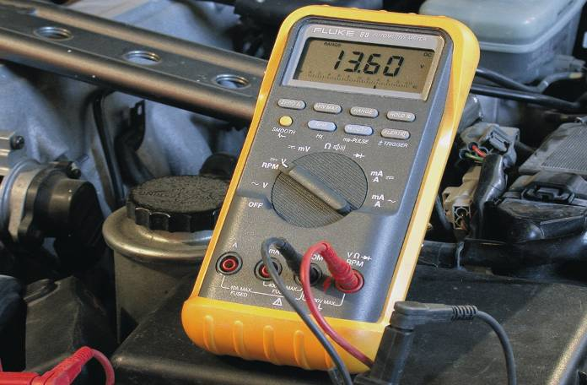
FIGURE 22–22 A multimeter is an important tool for today’s repair technician. It reads voltage, current, and resistance.

Slide 22
Electrical Diagnostic Equipment (continued)
Measuring resistance
Always disconnect circuit from power source
General procedure to measure resistance
Measuring voltage
Multimeters allow you to select alternating current voltage (ACV) or direct current voltage (DCV)
When using multimeters to measure voltage, selection of the range scale is very important

Slide 23
FIGURE 22–24 Note the various checks that can be made with a multimeter to determine taillight circuit problems. This type of analysis also applies to other types of circuits. (A) Check for power to the fuse panel. (B) Check for voltage after the main switch and fuse. (C) Check for voltage at taillight sockets. (D) An ohmmeter will check for grounds at taillights.

Slide 24
Electrical Diagnostic Equipment (continued)
Measuring current
Current or amperage measured to check consumption of power by a load
Measuring current in modern ammeters
Measuring current in older ammeters
High-current draw indicates low resistance
Dragging or partially shorted motor
Low-current draw means high resistance
Bad connection or dirty motor brushes

Slide 25
Electric Components
Switch: turns circuit on or off manually
Solenoid: electromagnet with movable core or plunger
Relay: remote control switch
Inertia switch: designed to shut electric fuel pump off after a collision
Motors: use permanent magnets and electromagnets to convert electrical energy into a rotation motion for doing work

Slide 26
FIGURE 22–26 This illustration shows the electrical components found in the engine bay of one vehicle. During a hard frontal collision, these parts can be smashed and damaged, requiring replacement.

Slide 27
Circuit Protective Devices
Prevent excess current from burning wires and components
Fuse box (or fuse panel) holds circuit fuses, breakers, and sometimes flasher units for turn and emergency lights
Fuses
Burn in half with excess current to protect a circuit from further damage
Fuse ratings: current at which fuse will blow

Slide 28
Circuit Protective Devices (continued)
Fuse links
Smaller diameter wires spliced into the larger circuit wiring for overcurrent protection
Also called fusible links
Circuit breakers
Heat up and open with excess current to protect circuit
Cycling circuit breakers
Noncycling circuit breakers

Slide 29
FIGURE 22–33 A circuit breaker uses a bimetal arm that bends with heat-generated current flow. If the current goes too high, heating of the bimetal arm causes it to bend and open circuit contacts. When the bimetal arm cools, it bends back to reconnect the circuit.

Slide 30
Lighting and Other Electrical Circuits
Automotive lighting systems have become increasingly sophisticated
Headlight assemblies often damaged in frontal collisions
Aiming headlights
Inspections that should be made before making adjustments to headlights
Headlight aimers: for adjusting headlights to shine at proper height and side direction in front of vehicle

Slide 31
FIGURE 22–38 Note how the shop wall and floor have been marked for aiming headlights. Pull a vehicle up to the line drawn 25 feet from the wall. Measure the headlight heights, the width between bulbs, and the centerline. Draw lines on the wall or mark them with masking tape. When the headlights are turned on, they should hit the wall on your alignment marks.

Slide 32
Lighting and Other Electrical Circuits (continued)
Tail, backup, and stoplights
Failure of tail, backup, stop, or directional light usually attributed to faulty bulb
Moisture getting into bulb socket causes corrosion of electrical contacts and bulb
Windshield wipers and washers
Horn
Most horn systems use steering wheel switch and relay for sounding the horn

Slide 33
FIGURE 22–42 This is a typical configuration of windshield wipers and washers. The wiper motor normally attaches to the firewall, either in the engine compartment or under the dash. The washer bottle is often cracked during frontal collisions and should be inspected for leakage and normal operation.

Slide 34
Lighting and Other Electrical Circuits (continued)
Starting and charging systems
Starting system
Large electric motor turns engine flywheel
This spins, or “cranks,” crankshaft until engine starts and runs on its own power
Charging system
Recharges battery and supplies electrical energy when engine is running

Slide 35
Lighting and Other Electrical Circuits (continued)
Electrical troubleshooting charts
Provide diagnostic procedures that are read from top to bottom in a specific sequence
Battery drain
Causes current to flow out of battery when everything should be off
Engine no-start
If an engine cranks but fails to start, check for “spark” and “fuel”

Slide 36
Electronic System Service
Many electronic diagnostic and repair procedures are not that difficult
Technicians can find and fix many electronic problems by:
Going back to basics of electrical circuits
Following few simple rules
Knowledge of electronics is necessary for technicians to perform their jobs

Slide 37
Electronic Displays
In collision repair, electronic displays call for special cautions
Most dashboard gauges are driven by some type of electrical signal
Gauges can either be analog or digital
Digital displays
Analog displays

Slide 38
FIGURE 22–50 (A) An analog display has gauge needles that sweep around. (B) A digital display has number displays and sometimes analog indicators that move or slide across to show vehicle speed, for example.

Slide 39
Electronic Displays (continued)
Display types
Light-emitting diode (LED)
Liquid crystal diode (LCD)
Vacuum fluorescent diode (VFD)
Air bags
Air bag system uses impact sensors, vehicle’s on-board computer, inflation module, and nylon balloon in steering column to protect driver during a head-on collision

Slide 40
Computer Systems
Almost all vehicle systems are now controlled by computer
Basic computer system consists of:
Sensors (input devices)
Actuators (output devices)
Computer (electronic control unit)
Antilock brakes
Antilock brake system (ABS): electronic/hydraulic “pumping” of brakes for straight line stopping under panic conditions

Slide 41
FIGURE 22–51 Computers, also called electronic control modules, can be found throughout the vehicle. When doing body repairs that require welding, computers should be protected from heat or removed.

Slide 42
Computer Systems (continued)
Computerized suspension
Uses sensors and electronic control unit to adjust height, leveling of car, and ride firmness
Computer-assisted steering
Electric motor replaces hydraulic pump, hoses, and fluid associated with conventional power steering systems
On-board diagnostics (OBD)
Computer system can detect its own problems
On-board diagnostics II (OBDII) systems

Slide 43
Computer Systems (continued)
Scan tool use
Scan tool: electronic instrument for reading trouble codes and converting them into problem explanations
Four categories of OBDII trouble codes
Computer problems
PROM: programmable read-only memory chip mounted in computer
May need to install from old computer to new computer when replacing a computer

Slide 44
Computer Systems (continued)
Protecting electronic systems
Procedures to protect automotive electrical systems and electronic components during storage and repair

Slide 45
Summary
Electrical repairs include tasks such as repairing severed wiring, replacing engine sensors, and scanning for computer or wiring problems.
Current is the movement of (electrons) electricity through a wire or circuit.
Voltage is the pressure that pushes electricity through the wire or circuit.
Resistance is a restriction or obstacle to current flow. It tries to stop the current caused by the applied voltage.
An open circuit is disconnected and does not have a complete electrical path.

Slide 46
Summary
A short circuit has an unwanted current path. A collision will sometimes create a short circuit.
If an engine cranks but fails to start, check for “spark” and “fuel.”
A conductor carries current to the parts of a circuit.
“Hot” wires connect the battery positive to the components of each circuit.
Insulation stops current flow and keeps current in the metal wire conductor.
A frame ground circuit uses the metal body as a return wire to the negative terminal of the battery.

Slide 47
Summary
A series circuit has only one conductor path, or leg, for current through the circuit.
A parallel circuit has two or more legs, or paths, for current.
A wiring diagram is a graphic representation of all parts and wires in the circuit.
Electrical symbols are graphic representations of electrical/electronic components.
Wire color coding allows you to find a specific wire in a harness or in a connector.

Slide 48
Summary
A wiring harness has several wires enclosed in a protective covering.
The battery stores electrical energy as chemical energy. Improper handling of batteries can cause severe acid burns, and ignited gas can cause the battery to explode.
A multimeter is a voltmeter, ohmmeter, and ammeter combined into one case.
A solenoid is an electromagnet with a movable core or plunger. When energized, the plunger is pulled into the magnetic field to produce motion.

Slide 49
Summary
A relay is a remote control switch.
A fuse box holds the various circuit fuses, breakers, and sometimes the flasher units for the turn and emergency lights.
Fuses burn in half with excess current to protect a circuit from further damage.
A fuse link, or fusible link, is a smaller diameter wire spliced into larger circuit wiring for overcurrent protection.

Slide 50
Summary
Circuit breakers heat up and open with excess current to protect the circuit. They do not suffer internal damage like a fuse.
The starting system has a large electric motor that turns the engine flywheel.
The charging system recharges the battery and supplies electrical energy when the engine is running.
A battery drain is a problem that causes current to flow out of the battery when everything should be off.

Slide 51
Summary
Sensors are devices that convert a condition (temperature, pressure, part movement, and so on) into an electrical signal.
Actuators are devices (solenoids or servo motors, for example) that move when responding to electrical signals from the computer.
A computer is a complex electronic circuit that produces a known electrical output after analyzing electrical inputs.

Slide 52
Summary
Modern antilock brake systems (ABS) can be thought of as electronic/hydraulic “pumping” of the brakes for straight-line stopping under panic conditions.
On-board diagnostics (OBD) means the computer system can detect its own problems.
A scan tool can convert the computer number code into an explanation of the problem.

