Slide 1
Door, Roof, and Glass Service
Chapter 15
Notes:
1

Slide 2
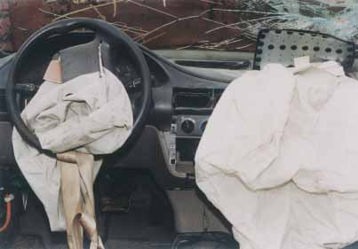
FIGURE 15-2 Lamination kept this windshield glass intact upon impact. Tempered glass would have shattered into small pieces. Air bag deployment often shatters windshield glass.

Slide 3
Objectives
Describe windshield glass replacement procedures
Compare different methods used to secure windshield glass
Remove, replace, and adjust door assemblies
Describe how to service both manual and power window regulators
Summarize door glass replacement and adjustment
Notes:
3

Slide 4
Objectives (continued)
Properly replace rearview mirror glass and heating elements
Explain how to replace and repair vinyl roofs
Answer ASE-style review questions relating to glass, trim, and other service operations

Slide 5
Introduction
Auto body repair technicians are frequently required to service vehicle glass
Technicians often service door glass and fastened stationary side glass
Most body shops “farm out,” or hire a glass technician to replace windshields and rear passenger compartment glass
Notes:
5

Slide 6
Vehicle Glass Technology
Today’s vehicles are built with a lot of glass for greater visibility
Glass is frequently broken out or cracked as a result of collision, air bag deployment, flying gravel, or vandalism
Types of glass
Two types of glass used in today’s vehicles: laminated and tempered
Notes:
6

Slide 7
Glass Service
Outside glass specialty shops are often hired to install windshields and back glass
Windshields and rear windows are usually secured in place by rubber weatherstripping or by adhesive
Generally, moldings are used on the interior and exterior of the body around glass opening
Notes:
7

Slide 8
Glass Service (continued)
Two windshield glass replacement methods
Rubber gasket installations
Adhesive installations
Full cutout method and partial cutout method
Removing windshield molding
Before removal of windshield glass or rear window, interior and exterior moldings must be removed
Clip removal tool is often needed to reach under molding to release the clip from under molding lip
Notes:
8

Slide 9
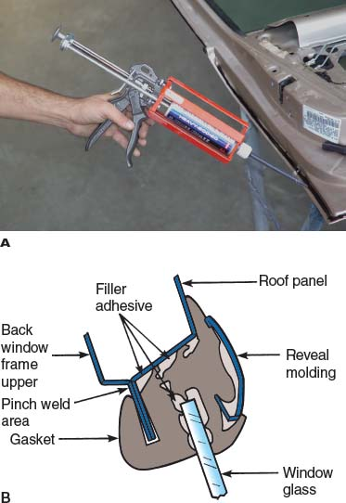
FIGURE 15-4 This windshield glass is secured with a rubber gasket. (A) A soft rubber gasket locks around the windshield glass and body structure. No adhesive is required with some designs. (B) This cutaway view shows how rubber gaskets secure windshield glass.

Slide 10
Glass Service (continued)
Removing windshield molding (continued)
On the exterior of vehicle, remove reveal moldings and other trim or hardware
Reveal molding can be secured in place by clips that are attached to body opening by welded-on studs, bolts, or screws
To remove molding from retaining clips, a special tool might be required
Notes:
10

Slide 11
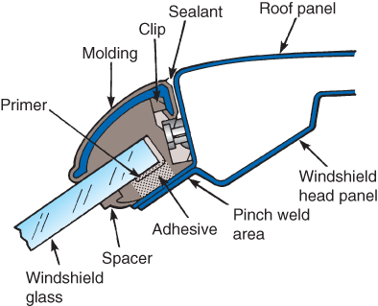
FIGURE 15-5 This cross section shows a bonded windshield with its molding.

Slide 12
Glass Service (continued)
Windshield rubber gasket service
Replacing windshield glass using gasket material is a 23-step process
Glass adhesive: full cutout method
This method involves complete removal of old adhesive sealer to remove glass
Replacing adhesive-bonded windshield is an 18-step process
Notes:
12

Slide 13
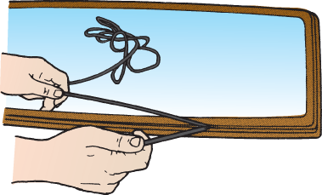
FIGURE 15-8 A cord in the pinch weld opening can be used to work the rubber gasket and windshield into position during installation.

Slide 14
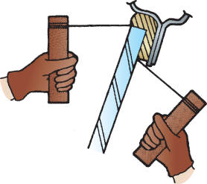
FIGURE 15-13 You can cut through windshield adhesive with piano wire.
Be extremely careful not to cut your hand!

Slide 15
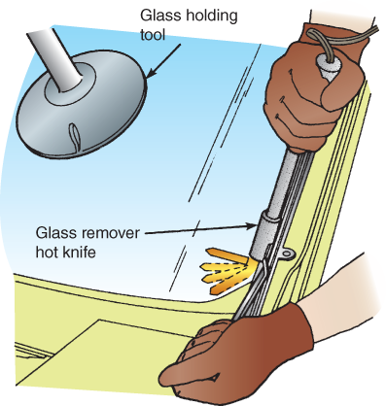
FIGURE 15-14 Windshield adhesive can also be cut with a hot knife.

Slide 16
Glass Service (continued)
Glass adhesive: partial cutout method
Thoroughly inspect the remaining adhesive
There must be sufficient adhesive remaining in pinch weld to give adequate clearance between body and glass
Adhesive must also be tightly bonded to the pinch weld to provide a good base for new adhesive
Replacing windshield using partial cutout method is a 23-step process
Notes:
16

Slide 17
Glass Service (continued)
Windshield wiper service
Specs for installing windshield wiper arms are usually given for arms in the down position
Adjustment can be made by engaging the arm into different teeth on the drive shaft
Rear and quarter window service
Removal and replacement procedures for rear windows are similar to windshield replacement
Quarter windows can be secured with rubber molding, adhesive, fasteners, or a combination of methods
Notes:
17

Slide 18
Servicing Doors and Liftgates
Doors must remain strong enough to stay closed and protect the driver and passengers from injury during a collision
Door construction
Two basic door designs: framed doors and hardtop doors
Manual and power regulators
Manual regulators: handle crank mechanism
Power regulators: electric motor-driven gear mechanism

Slide 19
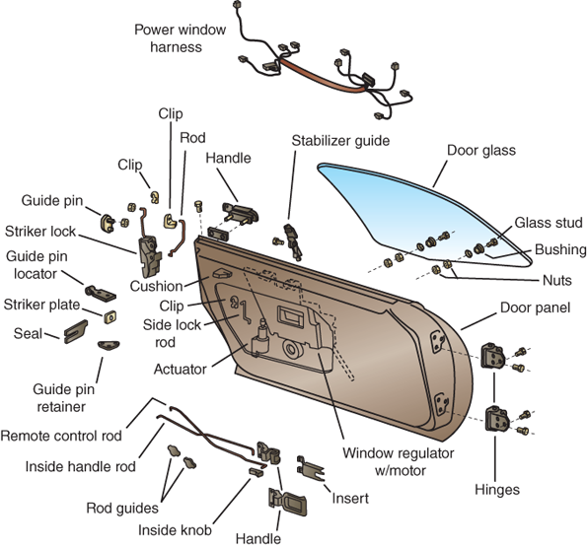
FIGURE 15-28 Study how the typical parts of a door are assembled.

Slide 20
Servicing Doors and Liftgates (continued)
Checking door operation
Nonparallel body gaps
Door sagging
Door hinge check
Door operational check
Door removal
To remove a typical door, remove the two door hinge bolts or drive out welded hinge pins
Disconnect wiring going into door frame and disconnect door hinges

Slide 21
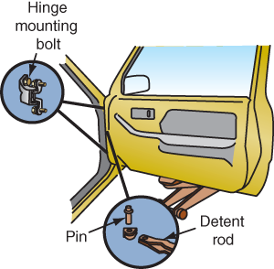
FIGURE 15-29 A floor jack covered with a shop towel or holding fixture is commonly used to support the weight of a door when loosening hinges. Have someone hold the door to keep it from falling when removing the last hinge bolt.

Slide 22
Servicing Doors and Liftgates(continued)
Door weatherstrip service
If weatherstrip has any holes, splits, or cracks, replace it to prevent air and water leakage in the passenger compartment
Door inner trim panel R&R
Remove screws that hold armrest and other trim pieces
Remove window handle and door handle
Pop out plastic clips installed around the perimeter of the panel

Slide 23
Servicing Doors and Liftgates (continued)
Door inner trim panel R&R (continued)
Disconnect any wires going to the panel
With door panel off, peel back any paper or plastic material over door
When replacing door inner trim panel, follow the reverse order of removal
Door window regulator service
Small nuts and bolts secure the window regulator and glass guides in position
Usually, the glass bolts to upper arms of regulator

Slide 24
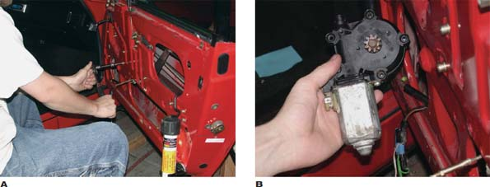
FIGURE 15-35 This technician is working on the inside of a door assembly.
(A) A drop light is essential for working inside a door frame. (B) A power window motor is normally held engaged with the window regulator with three or four small machine screws.

Slide 25
Servicing Doors and Liftgates(continued)
Door window regulator service (continued)
To remove glass, unbolt it from the regulator
Remove any parts that prevent glass from sliding out of door
If glass was broken, use vacuum cleaner to remove broken glass from inside the door before installing new glass
Door lock and latch service
Door handles can be replaced by raising window and removing interior trim panel, and water shield to gain access to inside of door

Slide 26
Servicing Doors and Liftgates(continued)
Door lock and latch service (continued)
Exterior door handles are often held on with screws or bolts
To remove the lock, pop off the small clip holding the lock rod, then pry clip off the lock
Slide lock and washer off the outside of door
Door reinforcements
Unibody vehicle doors have inner metal reinforcements at various locations
Reinforcements at hinge locations and door lock plate; intrusion beams inside side doors

Slide 27
Servicing Doors and Liftgates(continued)
Liftgates are common on SUVs, minivans and crossover vehicles
Power liftgates are growing in popularity
Test fit the new liftgate to the vehicle before refinishing
Liftgate hinges or vehicle structure could be bent
Make sure new liftgate closes properly before using automatic function

Slide 28
Door Panel (Skin) Replacement
Door panel is secured to the frame either with plug or spot welds or with adhesives
Replacing welded door skins
Replacing welded door skins is a 27-step process

Slide 29
Panel Adhesive Technology
Some vehicle manufacturers use structural adhesives to install door skins and other panels
Two-part epoxy adhesives
Also called weld-bond adhesives because spot welds can be placed through them
Replacing bonded door skins
Use heat gun to soften adhesive
Work around the flange with heat and putty knife or chisel until entire panel is removed

Slide 30
Panel Adhesive Technology (continued)
Replacing bonded door skins (continued)
Clean off old adhesive and apply new adhesive around frame flange
Place new panel down into place
Use clamping pliers and light pressure to secure panel in place as the adhesive cures
Replacing SMC door skins
Cut away the center of skin
Heat bonded areas and apply pressure with pry bar or chisel to remove rest of the material

Slide 31
Panel Adhesive Technology (continued)
Replacing SMC door skins (continued)
Remove remaining adhesive from door frame flange
Clean bonded areas of replacement skin with soap and water; allow it to dry; sand bonding areas to expose SMC fibers
Apply two-part adhesive to door frame flange
Set skin on door frame and lightly clamp it
Allow adhesive to cure; paint the door; reassemble it; mount it on the vehicle

Slide 32
Door and Door Glass Adjustments
Door installation involves reversing the removal procedure
Door frame adjustment is needed to ensure that the door will close easily and not rattle or leak water and dust
Servicing welded door hinges
Welded-on door hinges have no adjustment provisions
A pin is provided to remove the door for servicing hinges

Slide 33
Door and Door Glass Adjustments (continued)
Servicing welded door hinges (continued)
Half of the hinge that is to be installed on the door is predrilled to permit bolt-on installation
Half of the hinge must be rewelded on the pillar when it is replaced
Bolted door hinge adjustment
Door hinges must be adjusted to hold the door in the center of its opening when closed and also fit other body panels
Door striker must be adjusted to engage the latch smoothly

Slide 34
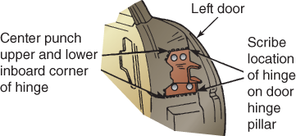
FIGURE 15-48 Scribing the hinge location can help rough adjust a door when you are reinstalling it.

Slide 35
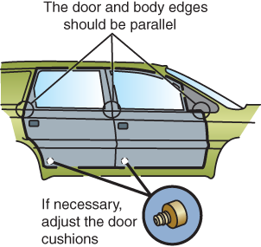
FIGURE 15-50 With a four-door vehicle, all body gaps or edges must be parallel and equal in width. Note the use of adjustable door stops on this vehicle.

Slide 36
Door Glass Service
Methods used to attach door glass to window lifting or regulator mechanism:
Bolt-through, or rivet, method
Adhesive, or bonding, method
Sash channel method
Door glass adjustment
By loosening nuts or bolts that hold channels and stops inside of door frame
Adjustable guide rollers in a moveable channel
Center lift guide

Slide 37
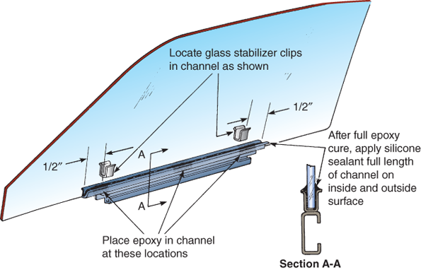
FIGURE 15-56 This is adhesive-bonded glass in a bracket. You would need to
refer to specific service information to get exact measurements for installing this glass.

Slide 38
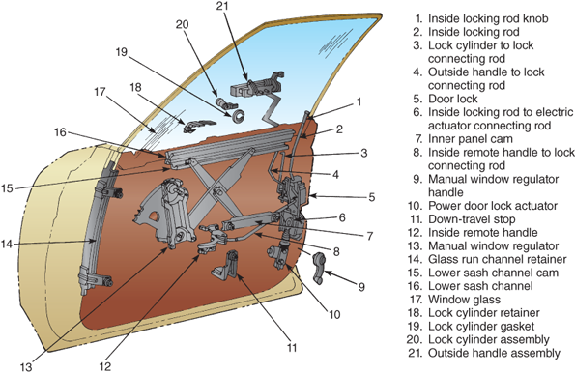
FIGURE 15-57 Study the X-design window regulator.

Slide 39
Door Glass Service (continued)
Door trim panel installation
After the door and its glass have been adjusted, reinstall all door trim pieces and other parts
Tailgate glass service
Tailgate glass is generally secured to a regulator with screws or bolts
Removal or replacement of tailgate glass is similar to procedures used for door glass

Slide 40
Door Glass Service (continued)
Glass element repair
Some heating elements built onto rear glass can be repaired when damaged
Special electrically conductive adhesive is used to bridge the gap in any breaks in heating element
Broken antenna and heating element wires can be reattached by soldering

Slide 41
Rearview Mirror Service
To service inside rearview mirror:
Use a sharp putty knife to remove old mirror mount; apply heat to mirror wedge and twist it back and forth with pliers
Use single-edge razor blade to scrape area clean
Spray clear primer where the mirror is going to be mounted and then, place a few drops of clear adhesive on windshield glass and mounting surface for the mirror

Slide 42
Rearview Mirror Service (continued)
To service inside rearview mirror (continued):
Press and hold mounting pad or mirror onto the glass to secure it
Sometimes a small screw that holds the mirror to its mounting pad needs to be tightened
If outside rearview mirror housing is damaged, the whole assembly is normally replaced

Slide 43
Rearview Mirror Service (continued)
Replacing outside mirror glass:
Glass is usually adhesive-bonded
Use heat gun to soften the adhesive; twist mounting pad each way until it releases from the glass
Use putty knife to pry off old mirror
Apply adhesive to the back of new mirror and tape it in place
Allow adhesive to cure for the recommended amount of time before tape removal

Slide 44
Roof Panel Service
Roof panels are often damaged in rollovers
A retractable hardtop roof might also need servicing
Fastened roof panel service
Replacement involves removing headliner and fasteners
Adhesive must be pried loose to remove old roof panel
Lip must be cleaned of old adhesive to prepare for installation of new roof panel

Slide 45
Roof Panel Service (continued)
Fastened roof panel service (continued)
Apply adhesive to mating surfaces, and have someone help you lower the new roof panel down into the adhesive
Tighten roof panel fasteners and wipe off any excess adhesive
Convertible top service
Convertible tops are often sent to an upholstery or specialty shop for service

Slide 46
Roof Panel Service (continued)
Sunroof service
Sunroof designs vary
Refer to service information for the particular make and model vehicle

Slide 47
Summary
Today’s vehicles are built with a lot of glass for greater visibility.
Laminated plate glass consists of two thin sheets of glass with a thin layer of clear plastic between them.
Tempered glass is used for side and rear window glass, but rarely for windshields.
Antilacerative glass is similar to conventional multilayered glass, but it has one or more additional layers of plastic affixed to the passenger side of the glass.

Slide 48
Summary
Interior moldings are called garnish moldings and exterior moldings are called reveal moldings.
Replacement of windshield glass involves two different methods based on the materials used: gasket installations or adhesive-type installations.
Most technicians use the windshield adhesive recommended by the manufacturer.
The outer panel, or door skin, wraps around the door frame and is clinched to the pinch weld flange.

Slide 49
Summary
Some manufacturers use structural adhesives in place of welds.
Door adjustment is needed so that doors close easily but do not rattle or leak water and dust.
Worn door hinges will have play that allows up and down movement of the rear of the door.
Oil is not recommended for use on the rubber window channels because it can cause the rubber to swell and deteriorate.
The window regulator is a gear mechanism that allows you to raise and lower the door glass.

