Slide 1
Hood, Bumper, Fender, Lid, and Trim Service
Chapter 14
Notes:
1

Slide 2
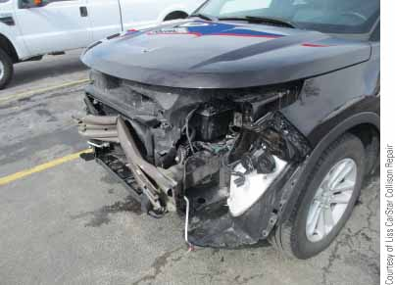
FIGURE 14-1 Many major body panels are held on with bolts, nuts, screws, clips, or adhesives. You must know how to efficiently remove and install these parts during collision repair.

Slide 3
Objectives
Remove and install fenders
List the various methods for adjusting mechanically fastened panels
Perform hood-to-hinge, hood height, and hood latch adjustments
Remove, install, and adjust deck lids
Remove, install, and adjust bumpers
List the precautions to follow when servicing bumper energy absorbers
Notes:
3

Slide 4
Objectives (continued)
Replace grilles and other bolt-on body parts
Service trim pieces on the outside of body panels
Answer ASE-style review questions relating to replacement of hoods, bumpers, fenders, deck lids, and trim pieces

Slide 5
Introduction
Many major parts bolt on to vehicles
On-the-job experience is the only way to become competent at body part removal and replacement
Sometimes you must remove one part at a time; sometimes, it is better to remove several parts as an assembly
Notes:
5

Slide 6
How are Fastened Parts Serviced?
Fastened parts
Held on vehicle by bolts, nuts, screws, clips, and adhesives
Many parts that were held on with bolts and screws in the past now snap-fit into place
Part removal sequence
Start by removing large, external parts first
Refer to vehicle’s service manual or computerized service information
Body repair section

Slide 7
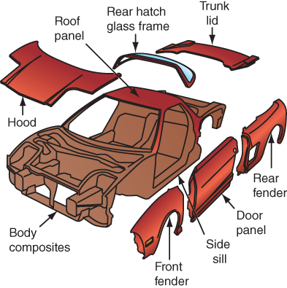
FIGURE 14-3 This high-performance sports car is a mid-engine design. Lightweight, rustproof aluminum panels, including the rear quarter panels, bolt to this advanced space frame.

Slide 8
Hood Service
Hood: one of the largest, heaviest panels on car or truck
Hood removal
Disconnect any wires and hoses
Hold hood open using hood prop tool as you remove shocks and other hood parts
Remove hood struts
Remove hood hinge bolts
Note location of any body shims or spacers that help adjust hood
Notes:
8

Slide 9
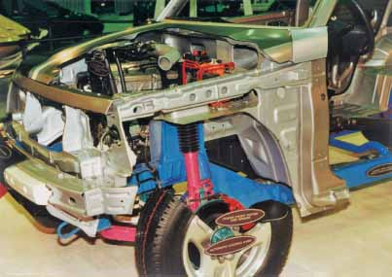
FIGURE 14-4 This display vehicle has had all bolt-on parts removed, including the hood, fenders, bumper, doors, and grill, exposing the unibody structure and suspension.

Slide 10
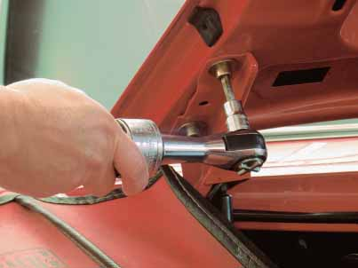
FIGURE 14-6 An air ratchet is handy for removing and installing hood hinge bolts. If they are not knocked out of alignment from collision, mark the hinge positions to simplify reassembly and realignment.

Slide 11
Hood Service (continued)
Hood hinge R&R
Hood hinges: allow hood to open and close while staying in alignment
Replace, if bent badly or damaged
Install new or repaired hood in reverse order of removal
Hood adjustment
At hinges, adjustable stops, and hood latch
Should align with cowl and fenders with equal gap between them
Notes:
11

Slide 12
Hood Service (continued)
Hood adjustment (continued)
Front edge of hood should be even with front edge of fender
Hood-to-hinge adjustment
Slightly loosen bolts attaching hood to hinges
Close hood and line it up properly until gap around all sides is equal
Raise hood far enough for another technician to tighten bolts
Make sure there is sufficient clearance between hood and cowl
Notes:
12

Slide 13
Hood Service (continued)
Hood height adjustments
Slightly loosen bolts holding hinges to fenders or cowl
Close hood and raise or lower rear edge of hood as necessary
When rear of hood is level with adjacent fenders and cowl, open hood and tighten bolts
Adjust rear and front stops
Notes:
13

Slide 14
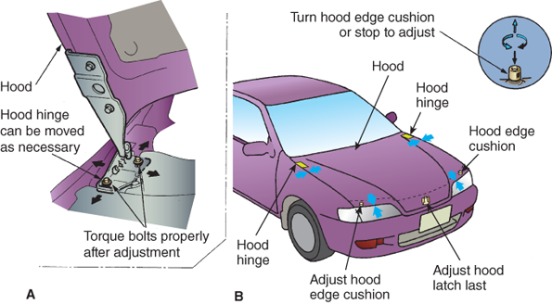
FIGURE 14-9 (A) When adjusting the hood alignment, loosen the hinge-to-body bolts slightly. This will let you shift the hinge mounting in the elongated holes right to left and fore to aft. To avoid paint damage, slowly lower the hood while checking alignment. Tighten the hinge bolts when the hood is aligned with the cowl and fenders. (B) Hood edge cushions or stops must be adjusted so that the height of the hood is even with the fenders. You may want to remove the latch during hood adjustment.

Slide 15
Hood Service (continued)
Hood latch mechanisms
Keep hood closed and release hood when activated
Most are opened by cable release that runs into passenger compartment
Cable hood release consists of four major components: hood release handle, hood release cable, hood latch, and hood striker
Notes:
15

Slide 16
Hood Service (continued)
Hood latch adjustments
Slowly lower hood and make sure it engages latch in the center
If hood must be slammed excessively hard to engage latch, raise latch
If hood does not contact front stoppers when latched, lower latch
Notes:
16

Slide 17
Bumper Service
Chrome bumpers that are severely damaged or have chipped chrome plating are usually sent to a shop that specializes in repairing and rechroming bumpers
Painted bumpers that are not too severely bent can be pulled and bumped back to shape using common shop procedures

Slide 18
Bumper Service (continued)
Bumper removal
Unplug wiring harness going to any lights
Before removing last mounting bolts, support bumper on floor jack
Get a helper to hold bumper on jack as you remove the final fasteners
Bumper energy absorbers
Cushion some of the impact of collision and reduce damage
Compress inward to help prevent bumper and other part damage during low-speed impact

Slide 19
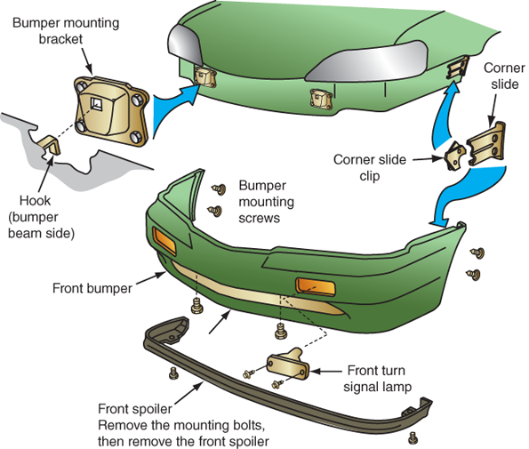
FIGURE 14-14 Various methods are used to secure the front bumper to a vehicle. Removal of lights and moldings often allows access to mounting hardware for removal of a bumper. Also note the screws and bolts that come in from the bottom and rear of a bumper.

Slide 20
Bumper Service (continued)
Bumper replacement
Removing bumper is basically a matter of removing correct bolts
After bolting bumper in place, it must be adjusted so that it is an equal distance from fenders and front grille
Clearance across the top must be even
Adjustments are made at mounting bolts

Slide 21
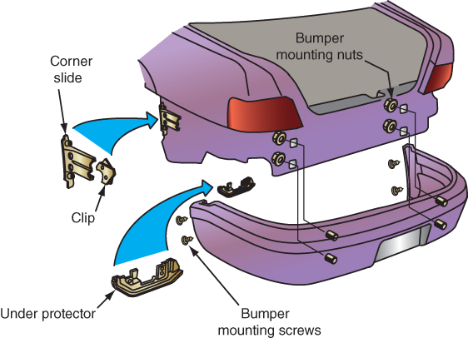
FIGURE 14-18 Note the typical fasteners used to secure the rear bumper assembly.

Slide 22
Fender Service
Commonly needed after frontal impacts
Fender removal
Find and remove all bolts securing fender to vehicle
Remove any wires going to fender-mounted lights
If old fender has factory-installed fender shims or spacers, note their locations during disassembly

Slide 23
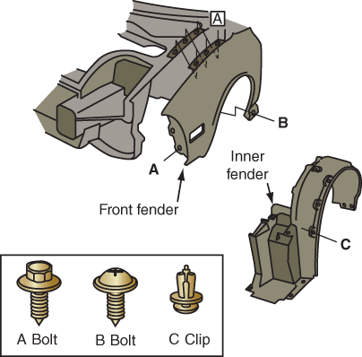
FIGURE 14-20 Fender bolts are typically located in these locations. Some are hidden behind the fender’s inner splash guard.

Slide 24
Fender Service (continued)
Installing fenders
Install replacement fender in reverse order of removal
Hand-start all fender bolts
Leave bolts loose enough so that you can adjust fender
Fender adjustments
Start adjusting and tightening fender bolts at the rear, next to the top of door
Obtain correct fender-to-door gap and correct fender-to-hood gap

Slide 25
Fender Service (continued)
Fender adjustments (continued)
Tighten fender bolts, working your way to the front of vehicle
Make sure curvature of fender matches shape of front door edge

Slide 26
Grille Service
Grilles are often held in place with small screws and clips
Air ratchet is handy for reaching down and unscrewing grille bolts
When installing grille, make sure all clips are undamaged and installed
Because most grilles are plastic, do not overtighten any bolts or screws
Most grilles have slotted or oversize holes in them for adjustment

Slide 27
Deck Lid and Hatch Service
Deck lid must be evenly spaced between adjacent panels
To prevent air and water leaks, deck lid must contact the weather-stripping evenly when closed
Trunk lid adjustments
Slotted holes in hinges and/or caged plates in the lid allow trunk lid to be moved forward, rearward, and side to side
Loosen attaching hardware to adjust lid

Slide 28
Deck Lid and Hatch Service (continued)
Trunk lid adjustments (continued)
Tighten attaching hardware after adjustment
Panel alignment
After installing all new body parts, you must check overall panel alignment
Make sure clearances between parts are equal
Check that surfaces of all panels are even with each other

Slide 29
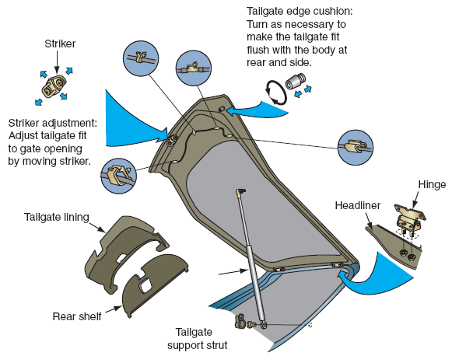
FIGURE 14-24 Study the parts that must be serviced to replace a rear hatch lid.

Slide 30
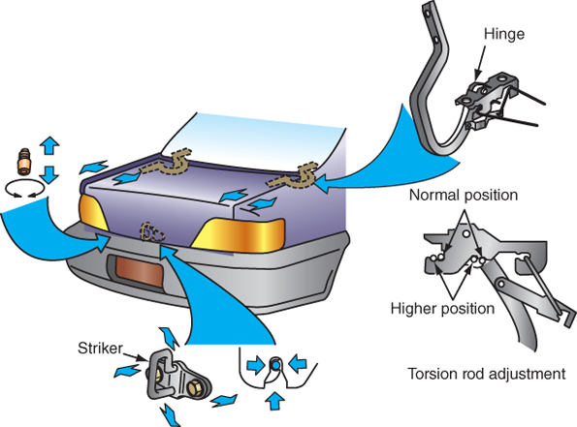
FIGURE 14-25 Servicing a deck lid is similar to servicing a hood. If the deck lid has torsion bar springs, it can complicate service, however. Deck lids sometimes have torsion rods instead of struts to hold the lid open. Be careful when removing these rods, because they are under pressure and can fly out of their slots. Many lid hinges slide into a box section formed in the panel. Do not lose any small spacers or other parts; keep them organized in a tray or plastic bag.

Slide 31
Truck Bed Service
Truck beds are usually bolted to a full ladder frame
To remove bed, remove bolts that extend up through brackets on frame
Keep track of bolt lengths and rubber mounting cushion locations
Must be reinstalled in their original positions
Tailgate hinges must be adjusted
Leave hinge bolts loose to adjust tailgate
Tighten hinge bolts and recheck adjustment

Slide 32
Sound-Deadening Pads
Often bonded to the inside surface of trunk cavities and doors to reduce noise, vibration, and harshness
During collision repair, sound-deadening pads must be replaced to match pre-accident performance
After repair, area must be properly refinished to provide corrosion protection before sound-deadening material is applied

Slide 33
Custom Body Panels
Aftermarket parts that alter appearance of vehicle
Spoilers, side skirts, air dams, etc.
Before installing, clean parts
Scuff sand parts to improve adhesion
Most custom body panels utilize original fasteners
Key to successful add-ons: proper alignment, careful positioning of new fasteners, and preparation of mating surfaces

Slide 34
Installing Body Trim and Moldings
Moldings enhance appearance of vehicle by hiding panel joints, preventing door dings, and accenting body lines
Also help weatherproof vehicle by channeling wind and water away from windows and doors
Removing adhesive-held moldings
Molding tool or power knife is used to cut through adhesive
Heat gun is sometimes recommended to soften adhesive before molding removal

Slide 35
FIGURE 14-30 Here are a few molding attachment methods.

Slide 36
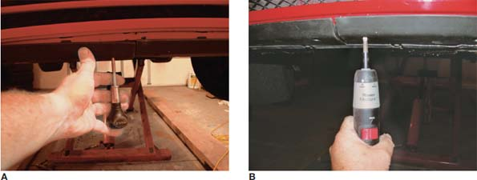
FIGURE 14-32 When installing large trim pieces like this lower front spoiler, it can be difficult to align all of the body clips. (A) A pointed awl can be inserted into holes to move clips into alignment. (B) An electric screwdriver will quickly run in all of the screws that secure the front spoiler.

Slide 37
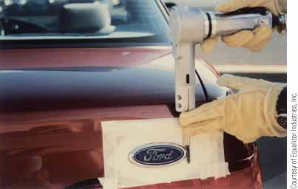
FIGURE 14-33 Place masking tape over the paint or finish to protect it when replacing emblems and moldings. You can then use a heat gun and electric knife to cut through an adhesive-held trim piece.

Slide 38
Installing Body Trim and Moldings (continued)
Installing adhesive body side moldings
Park car on level surface
Select area to which molding will be applied
Clean area with water and detergent, and then with wax-and-grease remover
Mark correct height of molding
If needed, cut molding to length
Peel six inches of protective backing paper from cut end of fender molding
Notes:
38

Slide 39
Installing Body Trim and Moldings (continued)
Installing adhesive body side moldings (continued)
Begin installing fender molding from fender rear edge
After whole length of molding is applied, press along entire length with heel of your hand or with roller

Slide 40
Summary
Keep in mind on-the-job experience is the only way to become competent and fast at body part R&R (part removal and replacement).
Fastened parts are held on the vehicle by bolts, nuts, screws, clips, and adhesives.
If in doubt about how to remove a part, refer to the vehicle’s service manual or computerized service information.
A common mistake during hood removal is forgetting to disconnect windshield washer hoses and wires. This can break or snap small hose fittings or sever wires.

Slide 41
Summary
To prevent part damage, have someone help you hold the hood. The hood is the largest adjustable panel on most vehicles. It can be adjusted at the hinges, at the adjustable stops, and at the hood latch.
Most vehicles have adjustable hood bumper stops mounted on the radiator support or along the inner edges of the fenders. After first installing the hood, close the hood slowly. If the hood is not centered, it could hit and dent the fenders.
Bumpers on many late model cars are covered with urethane or other plastics.

Slide 42
Summary
Bumpers can be heavy and clumsy. Before removing the last mounting bolts, support the bumper on a floor jack. Get a helper to hold the bumper on the jack as you remove the final fasteners.
Major front end damage sometimes requires removal of the large assemblies like the front clip or the bumper-spoiler assembly. This will give you better access to hard-to-reach parts on the assembly.
During paint edging, all ends, corners, edges, and sometimes the rear of the fender panel should be scuff sanded, primed, and painted.

Slide 43
Summary
Weatherstripping is a rubber seal that prevents leakage at the joint between the movable part (lid, hatch, door) and the body. To prevent air and water leaks, the deck lid or door must contact the weatherstripping evenly when closed.
Truck beds are usually bolted to a full perimeter frame. To remove the bed, simply remove the bolts that extend up through brackets on the frame.

