Slide 1
Estimating Repair Costs
Chapter 10
Notes:
1

Slide 2
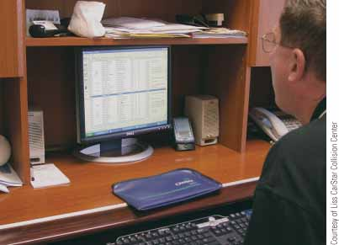
FIGURE 10-1 Estimators must have a thorough knowledge of vehicle construction, collision repair methods, and computer use to develop accurate estimates of repair costs.

Slide 3
Objectives
Explain the general purpose of damage estimates
Manually and electronically prepare an estimate
Outline the sequence for evaluating vehicle damage
Describe the method of determining the reparability of a damaged vehicle
Notes:
3

Slide 4
Objectives (continued)
Using gathered information, determine whether damaged parts should be repaired or replaced with new ones
Explain the difference between flat-rate labor time and overlap labor time when estimating repair costs
Calculate material costs based on a refinishing materials list
Use computer-based estimating programs

Slide 5
Objectives (continued)
Describe the benefits of using a digital camera, handheld computer, personal computers, and estimating software when preparing estimates
Answer ASE-style review questions relating to the estimating process

Slide 6
Introduction
Estimate: also called damage report or damage appraisal
Calculates cost of parts, materials, and labor for repairing collision-damaged vehicle
Repair costs are major consideration for both the owner and collision repair shop
Profit margins for collision repair shop depend heavily on accuracy of estimates
Notes:
6

Slide 7
The Estimate
Handwritten estimate
Using pen and paper or printed form to list all the information needed to calculate and bill customer or insurance company for doing repairs
Direct repair programs (DRPs)
Made up of cooperating insurance companies and body shops
Insurance company will approve a body shop for repairing vehicles insured by that insurance company
Notes:
7

Slide 8
The Estimate (continued)
Insurance deductibles
Owner is responsible for a given amount of the bill, usually the first $100 to $500
Remaining cost is paid by insurance company
Estimate time factors
Time taken to perform various repairs on vehicle is usually negotiated between estimator and insurance company or customer
Notes:
8

Slide 9
The Estimate (continued)
Work order
Printed form that outlines procedures that should be taken to return vehicle to its preaccident condition
Collision estimating guides
Help with filling out estimate
Contain vehicle identification information, price of new or recycled parts, time needed to install parts, identification of almost any part of car, and refinishing data
Notes:
9

Slide 10
Part Prices
Estimator must have the ability to compare cost of repairs against cost of new parts
Repair costs should never exceed replacement costs
Salvage parts
Used parts in good condition removed from totally wrecked vehicles by salvage yards
Notes:
10

Slide 11
Labor Costs
Flat rate
Preset amount of time and money charged for a specific repair operation
Job overlap
Replacement of one part duplicates some labor operations required to replace adjacent or attached part
Included operations
Jobs that can be performed individually but are also part of another operation
Notes:
11

Slide 12
Refinishing Time
Making correct estimate of the amount of labor time required to refinish panels, doors, hoods, etc., is a vital part of an estimator’s job
Flat-rate manuals list labor time plus materials allowance for various paint operations
Notes:
12

Slide 13
Estimate Total
Cost of parts, labor, and materials plus any extra charges, such as wrecker and towing charges, storage fees, and state/local taxes
From the estimate, work order can be written for the technician who is going to repair damaged vehicle
Notes:
13

Slide 14
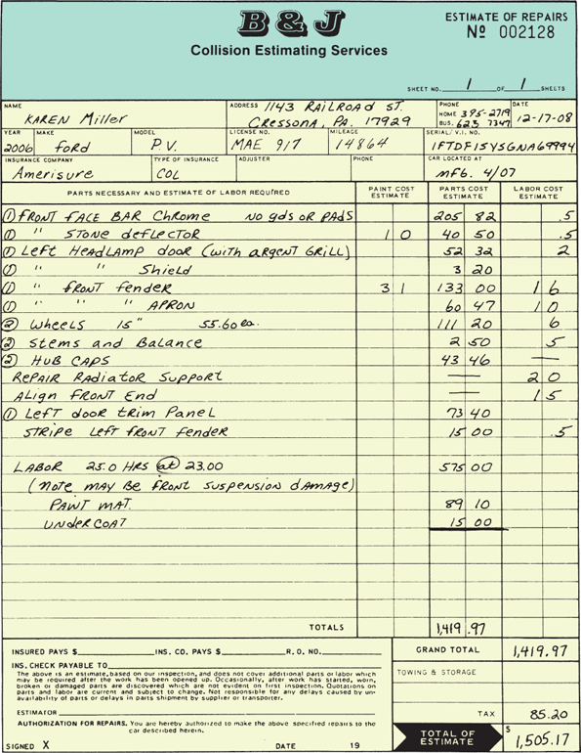
FIGURE 10-8 This is an example of a handwritten damage estimate or damage appraisal for parts and labor. Note the columns for tabulating paint cost, parts cost, and labor cost.

Slide 15
Computer Estimating
Computer-based estimating systems provide more accurate and consistent damage reports
Virtually eliminate math and logic errors
Computer components and jargon
Input devices, output devices, central processing unit (CPU), command, compact disc (CD), cursor, hard disc, hardware, memory, menu, modem, peripherals, program, software, etc.

Slide 16
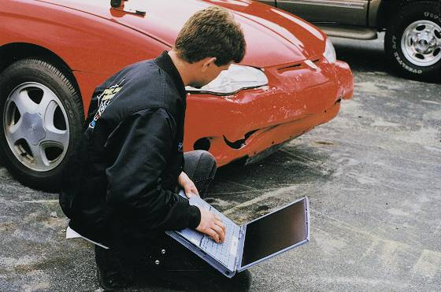
FIGURE 10-9 Most collision repair shops are now computer-based
to streamline and speed the estimating process. The estimator has
taken a laptop computer and estimating software out to a vehicle
with minor damage. Parts and labor needed can be input with a few
mouse clicks.

Slide 17
Computer Estimating (continued)
Types of computer estimating systems
Dial-up estimating system
In-shop estimating system
Downloading: linking two information holding devices (scanner, computer, laptop, etc.,) so they can exchange digital data

Slide 18
Computer Database
Contains all service information (estimating guides, labor rates, and part and material vendor information) in electronic form
Estimating program
Software that automatically helps to find parts needed and labor rates and calculate total cost for repairs
Program is often on computer floppy discs or on CD

Slide 19
Computer Database (continued)
Wireless estimating systems
Wireless laptop computer can be taken out to the damaged vehicle
Laptop can then use wireless communication to access main shop computer for pulling up part illustrations right at the vehicle
Imaging software
Allows you to utilize digital pictures of vehicle damage or of a specific part with your computer estimating system

Slide 20
Computer Database (continued)
Imaging software (continued)
Provides instant access to any photo ever entered into the computer system
Computer part lists
Part and labor prices are stored in the computer database allowing parts to be ordered quickly and easily
Automatic overlap deduction
Most estimating programs automatically deduct for overlap

Slide 21
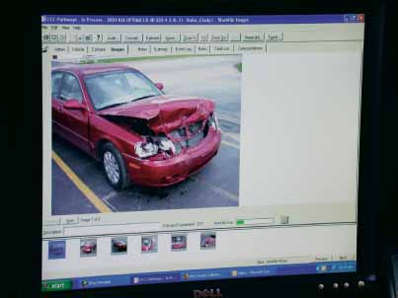
FIGURE 10-16 Viewing high-resolution photos full screen will let you double-check that all damaged parts have been found and the estimate is written accurately. You can also e-mail the photos to the insurance adjuster,
if needed.

Slide 22
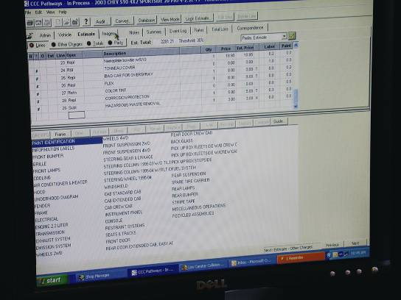
FIGURE 10-17 In this estimate window, you can add repair operations,
a description of the repair, part prices, and labor costs for the damaged sections of the vehicle. By clicking on one of the categories along the bottom, you will be shown exploded assembly views.

Slide 23
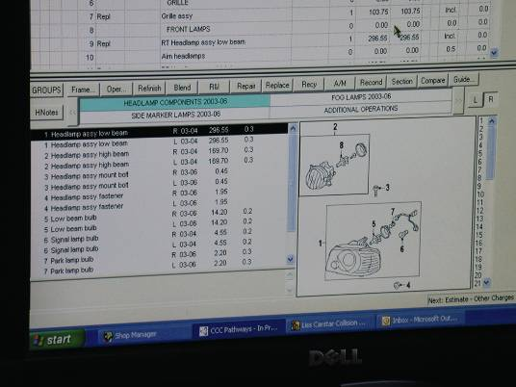
FIGURE 10-18 In the exploded view window, you can click on each damaged part, down to individual screws and clips. This will load each part name, its price, and labor time into the estimate for that vehicle.

Slide 24
Estimating Sequence
When estimating damage to vehicle, a logical sequence must be followed
Most estimators start from outside of car and work inward, listing everything, by car section, that is found bent, broken, crushed, or missing
Types of damage
Find all damage, no matter how minor
After noting obvious exterior damage, look for hidden damage

Slide 25
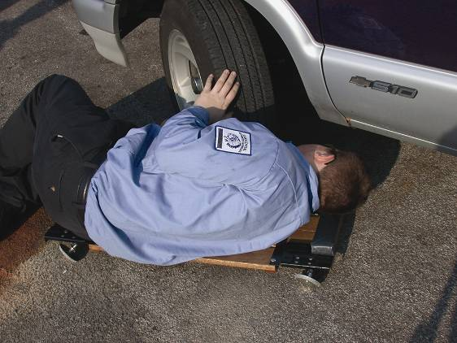
FIGURE 10-22 If the vehicle sustained a hard hit or had tire and
wheel damage, always look under it to find undercarriage damage.

Slide 26
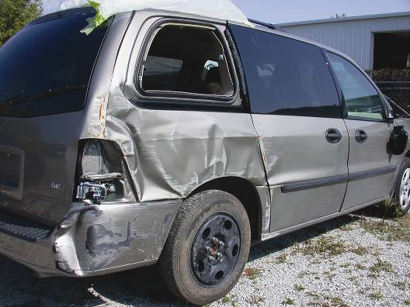
FIGURE 10-24 The rear of the van contacted the wall with greater force, knocking out rear glass and badly crushing a quarter panel. The quarter panel and rear bumper cover will require replacement. The rear hatch and side door are repairable.

Slide 27
Estimating Sequence (continued)
Types of damage (continued)
If applicable, open hood and check in engine compartment for damage
Look for cracked sealer or undercoating, which indicates that metal panels have been pushed out of alignment
Find indirect damage
Damage that happens to vehicle during the moment of impact or immediately after impact
Always look for indirect damage when writing an estimate

Slide 28
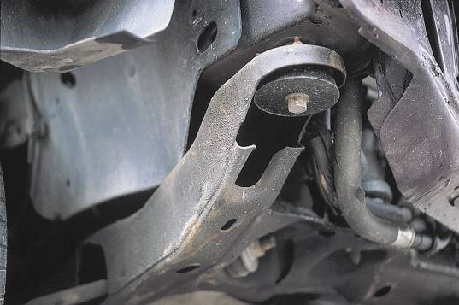
FIGURE 10-26 When looking under vehicle or inside wheel openings, check for cracked sealer, missing undercoat, and movement of parts. This engine cradle shows movement, indicating major front-end damage.

Slide 29
Estimating Sequence (continued)
Finding frame damage
Look for buckles in frame members
Search for fasteners that have moved
Look for displaced, cracked, or fractured undercoating underneath body structure
Check crush zones on frame rails
Wheel and suspension damage
Always inspect inside and outside lips of wheels for cracks and damage

Slide 30
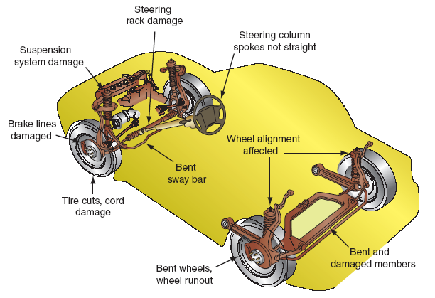
FIGURE 10-31 Note the types of damage that often happen to suspension, brake, and steering systems.

Slide 31
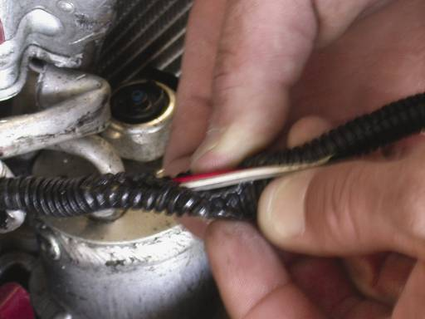
FIGURE 10-32 With major structural damage to a vehicle, wiring harnesses are often damaged. The cost of purchasing and installing new wiring harnesses would have to be added to the estimate.

Slide 32
Estimating Sequence (continued)
Passenger compartment damage
Interior of vehicle must be checked closely for damage
Air bag deployment can damage parts such as windshield or trim pieces
Measuring damage during estimating
“Eyeballing” technique is not enough to detect frame misalignment
Use measuring equipment to check for misalignment

Slide 33
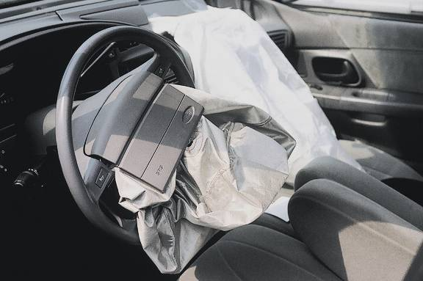
FIGURE 10-33 The vehicle’s interior or passenger compartment is another area that can be costly to fix after a bad accident. Air bags, the dash panel, seats, glass, and carpets can all be damaged by flying bodies, blood, and air bag deployment.

Slide 34
Estimating Sequence (continued)
Hidden damage
Hidden damage clause: permits added charges to original estimate when hidden damages are discovered after exterior panels or parts are removed for repairs

Slide 35
Vehicle Total Loss
Occurs when cost of repairs exceeds value of vehicle
Most companies will total vehicle at 70-80% of vehicle cost
Blue book
Lists market values for used vehicles in various conditions
Total loss software
Helps organize vehicle damage data into easily understood reports

Slide 36
Vehicle Total Loss (continued)
Total loss software (continued)
Reports contain all information insurance claims adjusters need to reach fair and equitable settlements
Often allows claims adjusters to find truly comparable vehicles that closely match total loss vehicle

Slide 37
Damage Analysis and Repair Blueprinting
Customer Relations
The customer can be an excellent resource when it comes to vehicle damage analysis
Finding hidden damage early in the repair process leads to faster repair times and increased customer satisfaction

Slide 38
Damage Analysis and Repair Blueprinting (continued)
Damage Analysis
Wash and dry the vehicle
Walk around the vehicle with the customer and take pictures of all four sides
Include the VIN and paint code on the estimate

Slide 39
Damage Analysis and Repair Blueprinting (continued)
Blueprinting
Process used to perform a thorough damage analysis and make a repair plan
Requires disassembly of damaged or affected areas
Document any structural damage with three-dimensional measuring
Gather vehicle specific repair information

Slide 40
Specific Systems to Inspect During the Blueprinting Process
Safety Systems
Electrical Systems
ABS, traction and stability control systems
A/C systems
Steering and suspension systems

Slide 41
Judgment Items
The amount of dent damage that can be hidden by a dollar bill would be 2-3 hours of body labor
A scratch that could be covered by a sheet of notebook paper would generally be 1 hour of body labor
Type of material, damage location and severity of damage must be considered

Slide 42
Replacement Parts
Different part sources
New factory parts
Recycled parts
Aftermarket parts

Slide 43
Use a Checklist
Checklists are commonly used in Collision repair for:
Estimating/blueprinting
Inspection of vehicle systems
Repairs
Clean-up

Slide 44
Summary
An estimate, also called a damage report or an appraisal, calculates the cost of parts, materials, and labor for repairing a collision-damaged vehicle.
An estimate is a firm bid for a given period of time—usually 30 days.
Computerized estimating systems using a personal computer (PC) provide more accurate and consistent damage reports.

Slide 45
Summary
An in-shop estimating system has all of the data needed at the shop office, usually on CDs.
A total loss occurs when the cost of the repairs exceeds the value of the vehicle.
The flat rate is a preset amount of time and money charged for a specific repair operation.

