Slide 2
seeds
leaf
petal
stem
flower
Can you think which part is missing from the picture?
Copyright © 2016 A Dab of Glue Will Do www.adabofgluewilldo.com

Slide 3
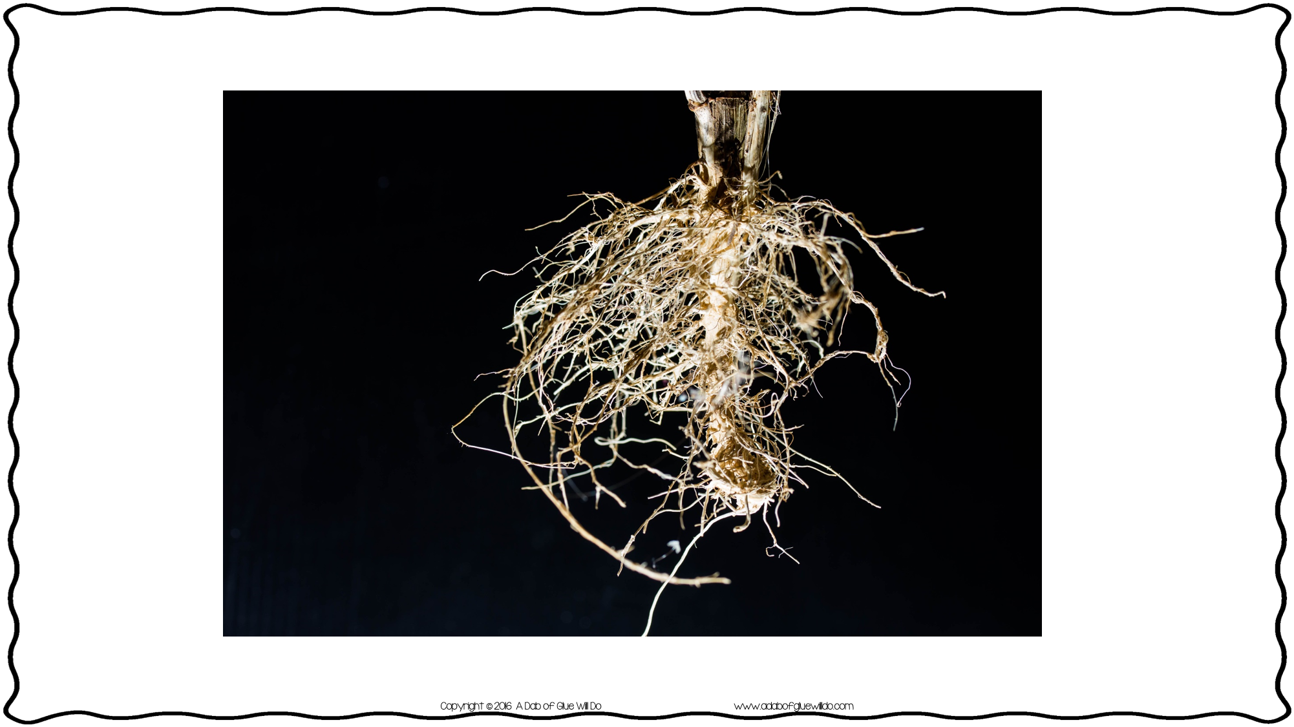
roots

Slide 4
It makes the flower look pretty
It attracts insects by their color and smell so they can pollinate the flower and make more seeds

Slide 5
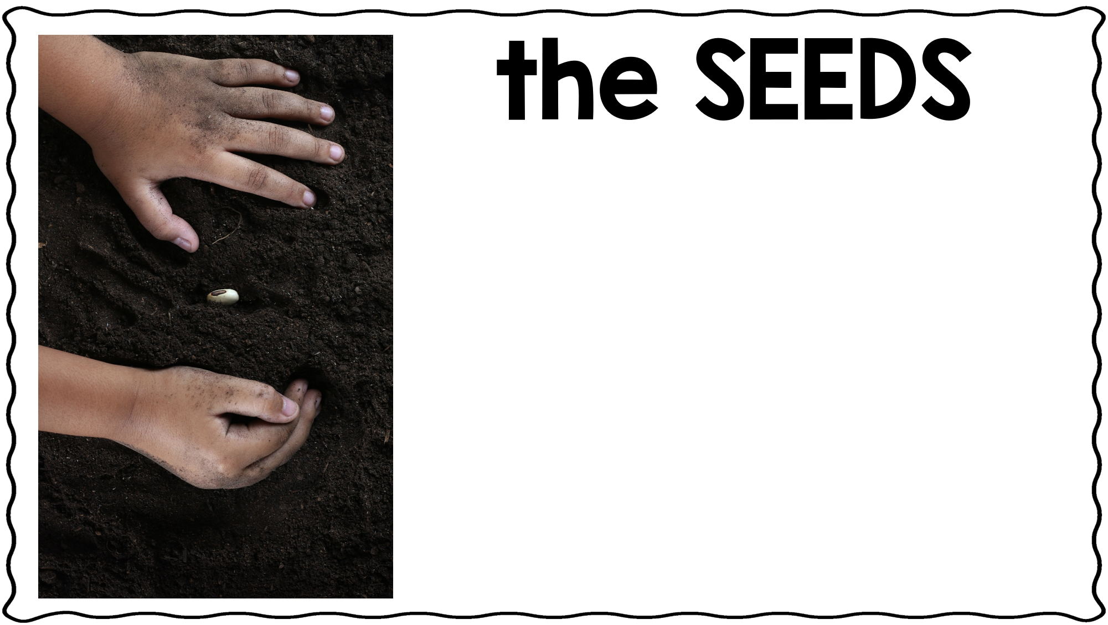
It makes new flowers
It makes food until the plant is big enough to make its own

Slide 6
It makes food for the plant
Takes in carbon dioxide and makes oxygen

Slide 7
It stands the plant up
It takes the food and water to the rest of the plant

Slide 8
It holds the plant in place
It sucks in water and food from the soil

Slide 10
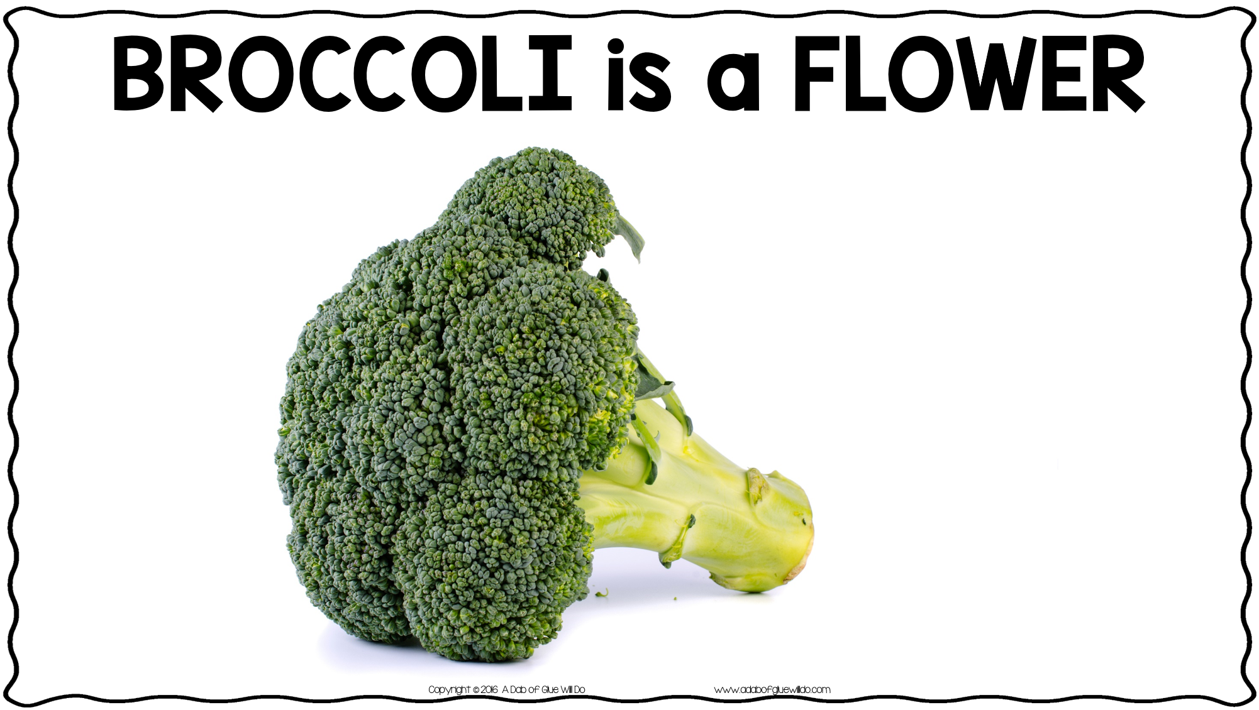

Slide 12
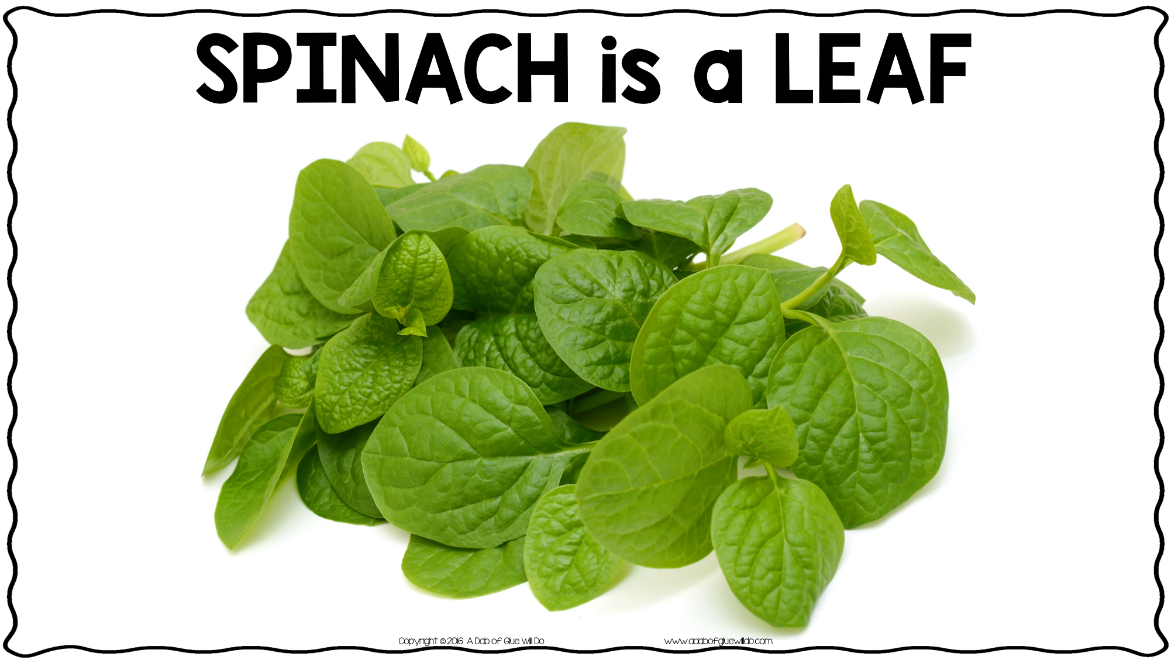

Slide 13
