Slide 1
Vehicle Surface Preparation and Masking
Chapter 25
Notes:
1

Slide 2
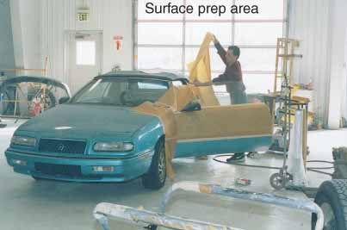
FIGURE 25–1 After sheetmetal work is done, a vehicle is moved to the surface prep/masking area.

Slide 3
Objectives
Determine whether an existing finish is defect free and adheres soundly to a vehicle
Select the correct abrasive and sanding techniques for specific final sanding operations
Prepare existing paint films and bare metal substrates for refinishing
Describe the three methods of removing a deteriorated paint film
Notes:
3

Slide 4
Objectives (continued)
Determine when to apply a primer, a primer-sealer, a primer-surfacer, or glazing putty
Prepare plastic parts for refinishing
Mask a car, panel, or spot repair for refinishing
Comply with EPA rules
Correctly answer ASE-style review questions relating to vehicle surface preparation and masking

Slide 5
Introduction
Surface preparation
Getting body surface clean, smooth, primed, puttied, sanded, scuffed, and wiped clean to ready it for painting
Proper surface preparation is the foundation of a good paint job
Notes:
5

Slide 6
Evaluate Surface Condition
Vehicle surface evaluation
Determine what must be done before painting body surface
Check gloss level, adhesion and surface rust
Checking paint thickness
Measured in mils, or thousandths of an inch (hundredths of a millimeter)
Original OEM paints: about 3 to 6 mils thick
Paint buildup should be limited to no more than 12 to 14 mils

Slide 7
Evaluate Surface Condition (continued)
Checking paint thickness (continued)
Mil gauge, also called paint thickness gauge, can be used to measure thickness of paint
Pencil mil gauge
Electronic mil gauge

Slide 8
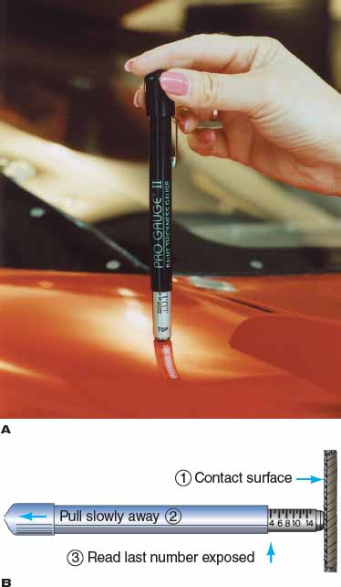
FIGURE 25–5 (A) A Tinsley gauge, also called a pencil mil gauge, is an inexpensive but effective way to check paint thickness in three steps. (B) By pulling the gauge, a magnet will stick to a steel body but will not work on aluminum or plastic panels. Thicker paint will allow you to pull the tool off the vehicle body with less effort.

Slide 9
Paint Removal
Three common ways to strip paint from metal surfaces
Chemical stripping
Media blasting
Sanding or grinding
Chemical paint removal
Chemical paint remover can be used for stripping large areas of paint if environmental regulations allow
No danger of metal warping

Slide 10
Paint Removal (continued)
Blasting off paint
Blasters: air-powered tools for forcing sand, plastic beads, or another abrasive onto surfaces for paint removal
Preferred when trying to remove surface rust
Types of media blasters
Pressure blasters
Siphon blasters

Slide 11
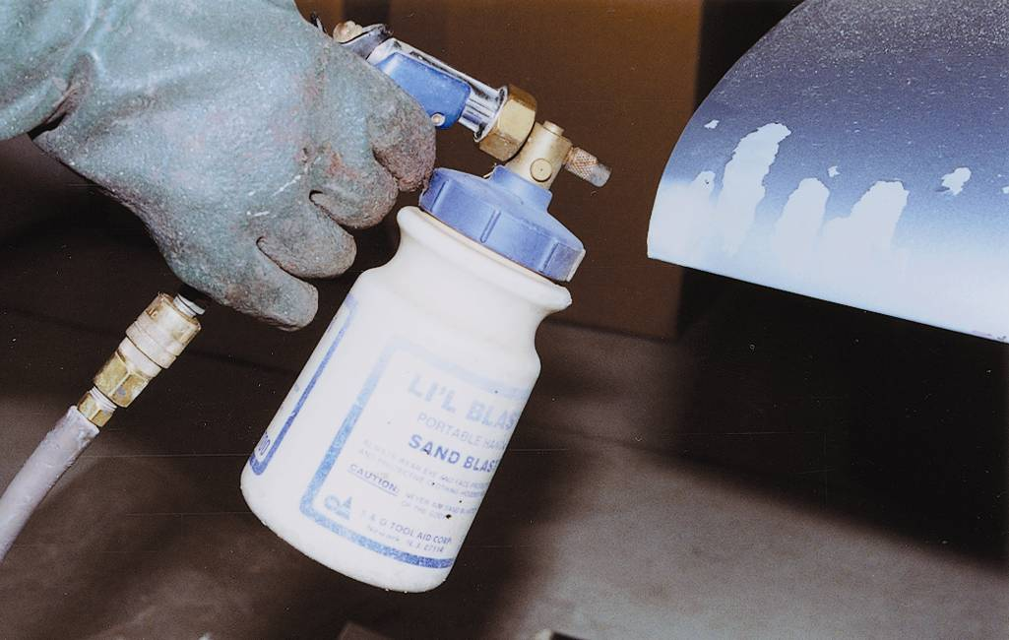
FIGURE 25–7 Media blasting is a fast and effective way to remove paint from smaller areas.

Slide 12
Paint Removal (continued)
Types of blasting media
Plastic media blasting
Sand blasting
Soda blasting
Using a blaster
Basic procedure for operating a blaster:
Mask off areas that will not be affected by spot repair
Put on necessary safety gear

Slide 13
Paint Removal (continued)
Using a blaster (continued)
Before blasting, check manufacturer’s instructions for proper blasting pressures, sand load procedures, and setup arrangements
When ready to blast, apply abrasive material directly onto area to be blasted; when area shows no brown rust, remove pressure
Watch surface carefully
After paint is removed, use air blowgun to remove sand from all areas of vehicle
Prime metal as soon as possible after any stripping process

Slide 14
Paint Removal (continued)
Sanding off paint
Orbital sanding with flexible backing pad is suitable for removing old finish from small flat areas and gently curved areas

Slide 15
Preparing Bare Metal
Proper preparation of bare metal is a critical step in restoring vehicle to its preaccident condition
Using metal conditioners
Metal conditioner: acid-type chemical wash that eats away any material that might prevent good primer-to-metal bond
Wipe-on metal conditioners are seldom used today
Might be used when surface rust could pose a problem

Slide 16
Preparing Bare Metal (continued)
Preparing hard chrome surfaces
Clean metal with wax-and-grease remover
Thoroughly sand metal
Reclean with wax-and-grease remover
Apply metal treatment
Spray two coats of primer-surfacer; allow adequate drying time before dry sanding
Blow out cracks, then use a tack cloth on entire surface; final coat can then be applied

Slide 17
Preparing Bare Metal (continued)
Preparing metal replacement parts
Shipping coating: protects metal against corrosion and rust during storage and shipping
E-coat: paintable primer that is an essential part of factory corrosion protection warranty on new factory panels and parts
Using self-etch primer
Self-etch primers chemically eat into bare metal to improve paint adhesion and corrosion resistance while also priming the surface

Slide 18
Preparing Bare Metal (continued)
Apply seam sealer
Seam sealer: needed anywhere water leakage might be a problem between panel joints—often on welded panels forming passenger compartment and trunk areas

Slide 19
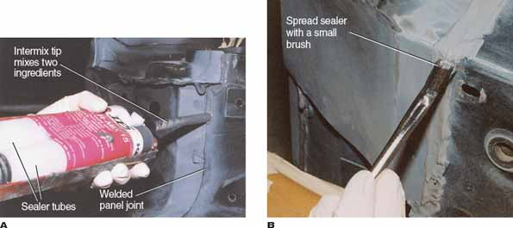
FIGURE 25–12 In the prep area, you must also check for correct application of seam sealer. (A) The sheetmetal technician forgot to apply seam sealer here. If the vehicle had been painted and leaked, the painter might have had to repaint the vehicle for free. (B) Use a small brush to smoothly spread seam sealer. You want it to look like the original OEM sealer. Brushing will also improve bonding of sealer.

Slide 20
Primecoat Selection
Decision to apply primer, primer-sealer, adhesion promoter, or primer-surfacer depends on the following three factors
Condition of substrate: smooth or rough, bare or painted
Type of finish on substrate if painted
Type of finish to be used for topcoat

Slide 21
Primecoat Selection (continued)
Applying primecoats
Reduce primecoat chosen according to manufacturer’s instructions
Select proper solvent for the weather conditions and thoroughly mix the material
Generally, only one or two coats of primer or primer-sealer are required
Primer-surfacer and primer-filler also require one or two coats for proper buildup

Slide 22
Primecoat Selection (continued)
Applying spot putty
Once primer is dry, any remaining small pinholes and scratches must be filled with spot putty, or glazing putty

Slide 23
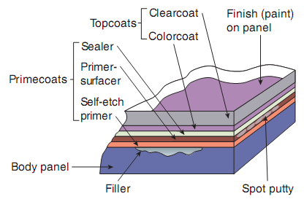
FIGURE 25–17 Note how different layers of repair materials are often applied during panel repair.

Slide 24
Final Sanding
Involves using fine and very fine grits of material to prepare body surfaces for painting
Entire surface to be refinished must be scuff sanded to improve adhesion of new paint
Use the right grit
Correct grit or sandpaper coarseness
Lower the number on the back of the sandpaper, coarser the grit
Start work with coarsest grit practical
Gradually go to finer paper to achieve desired surface smoothness

Slide 25
Final Sanding (continued)
Surface sanding methods
Refinishing sanding can be done by hand or by using power equipment
Power sanding
Orbital sander, or DA sander, moves in two directions at the same time
Produces much smoother surface finish
Used to featheredge repair area and to final sand larger panel areas

Slide 26
Final Sanding (continued)
Hand sanding
Simple back and forth scrubbing action with sandpaper flat against the surface
Can be done with your fingers on sharply curved surfaces
On flat or large curves use sanding block to support sandpaper
Dry sanding
Wet sanding

Slide 27
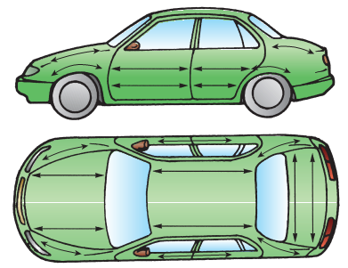
FIGURE 25–28 Generally, sand with the body lines of a panel. This will speed your work and help to prevent paint runs on the side of the vehicle.

Slide 28
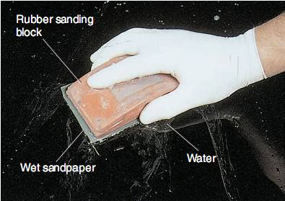
FIGURE 25–31 When final wet sanding flat or gently curved surfaces, use a sanding block. The block will help plane down and level minor surface imperfections much better than just using your hand.

Slide 29
Final Sanding (continued)
Surface scuffing
Using very fine or ultrafine abrasive (paste material, sandpaper, or scuff pad) to cut microscopic scratches in the body surface to be painted
Finely scratches surface to aid proper paint adhesion

Slide 30
Masking
Keeps paint from contacting areas that are not meant to be refinished or painted
Four basic ways to mask
With masking paper and masking tape
With plastic sheeting and masking tape
With specially shaped cloth or plastic covers (for wheels, antenna, and rearview mirrors)
With liquid masking material

Slide 31
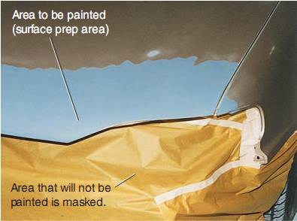
FIGURE 25–38 Masking materials are used to cover panels and parts that will not be painted.

Slide 32
Masking (continued)
Clean before masking
Before any types of masking materials are applied, vehicle must be completely cleaned and all dust blown away
Liquid masking material
Seals off large, complex surfaces of vehicle to protect them from paint overspray
Used on areas such as wheel wells, headlights, grille, underbody chassis, engine compartment, etc.

Slide 33
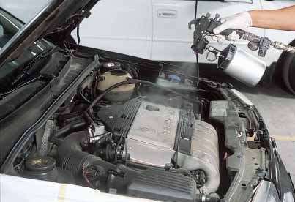
FIGURE 25–40 Liquid masking material is often used on large surfaces that will not be painted. After painting, liquid mask material washes off with soap and water or with a pressure washer. Here a spray-on mask is being applied to the engine compartment to protect the engine and other parts from overspray.

Slide 34
Masking (continued)
Plastic sheet masking
Very thin clear plastic that can be used to cover and protect large body surfaces from overspray
Masking paper and tape
Use correct type of masking paper as recommended by the manufacturer
Primer masking paper
Paint masking paper

Slide 35
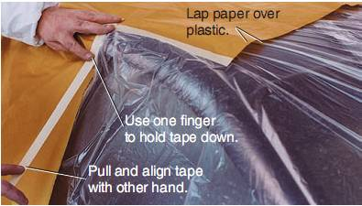
FIGURE 25–42 The masking paper should lap over the plastic. Tape the plastic to the body and then the paper to the plastic.

Slide 36
Masking (continued)
Masking paper and tape (continued)
Masking tape: very sticky paper tape designed to cover small parts and also to hold masking paper in place
Fine line masking tape
Masking versus removing a part
Decision to remove or mask depends on the design of vehicle, insurance company stipulations, and expectations of the customer
Decal and tape stripe removal

Slide 37
Masking (continued)
Applying masking tape and paper
Blow and wipe parts off before masking them to ensure good tape adhesion
When applying masking tape:
Hold and peel tape with one hand
Use your other hand to guide and secure tape to vehicle
Tape down all loose paper and plastic, and large areas of masking paper
Tape along the bottom of vehicle to hold paper on the bottom of the body

Slide 38
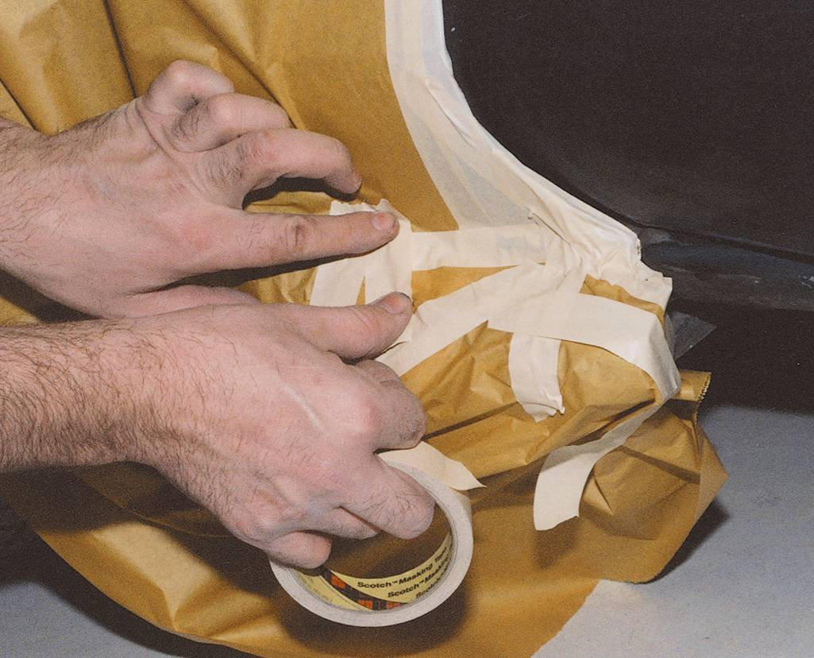
FIGURE 25–52 Make sure loose masking paper cannot flop and hit wet paint. Airflow from a spray gun can make loose paper blow around. Tape around or over all loose ends.

Slide 39
Masking (continued)
Applying masking tape and paper (continued)
Masking leak problem
Overmask and undermask problem
Double masking
Masking aids
Wheel masks: preshaped plastic or cloth covers that fit over vehicle’s wheels and tires
Preshaped plastic antenna, headlamp, and mirror covers

Slide 40
Masking (continued)
Masking panel gaps
Back masking: applying tape to the rear or inside edges of panels so that only front of panel is painted
To back mask a panel gap:
Apply tape along the back of panel so that tape sticks out enough to cover the gap between adjacent panels
Close door or hood and push tape back into part gap

Slide 41
Masking (continued)
Masking openings
Masking openings in panels
Masking wheels and wheel openings
Masking hood or trunk lid
Masking door openings
Reverse masking
Done by rolling tape over and into a curved shape to prevent visible paint parting line along masking tape
Masking rope

Slide 42
FIGURE 25–56 Note the two methods for masking a wheel opening. (A) Because only the rear bumper is to be painted, the whole wheel opening did not have to be fully masked. (B) Full wheel opening masking is needed when painting the panel area over or around the opening.

Slide 43
Surface Cleaning
Before pulling vehicle into paint booth, blow it off again
Remove contaminants, especially tar and grease, from surface before final sanding
Clean surface again right before painting
Oil from air tools or your hands can contaminate vehicle surface and cause problems when spraying on topcoats

Slide 44
Surface Cleaning (continued)
Using wax-and-grease remover
Before and after sanding, use wax-and-grease remover or recommended solvent to thoroughly clean the surface
Maximum effectiveness is achieved by wiping up wax-and-grease remover while it is still wet
To remove any last trace of moisture and dirt from seals and moldings, blow them out with compressed air at low pressure
Always include some wax-and-grease cleaner or detergent in sanding water

Slide 45
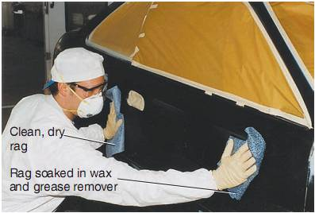
FIGURE 25–71 After surface preparation, the vehicle should again be wiped down with wax-and-grease remover. Use one clean rag to apply the cleaning agent. Use another dry rag to wipe the cleaner off right away before it dries.

Slide 46
Summary
The term surface preparation refers to getting a vehicle’s surface clean, smooth, and ready for the application of the final colorcoats.
A dull primer surface may look smooth and ready for paint to the untrained eye. You must remember that the paint will actually work like a magnifying glass to exaggerate any scratches or irregularities.
Before painting, you should identify the type of paint and overall condition of the existing paint system.

Slide 47
Summary
Paint thickness is measured in mils or thousandths of an inch. OEM paints are typically about 3–6 mils thick.
Blasters are air-powered tools for forcing sand, plastic beads, or another material onto surfaces for paint removal. A chemical paint remover can also be used for stripping large areas of paint if environmental regulations allow.
Sanding uses an abrasive-coated paper or plastic backing to level and smooth a body surface.

Slide 48
Summary
Grit sizes vary from coarse to ultrafine grades and are rated by number.
Power grinding is done to quickly remove large amounts of old paint and other materials.
When sanding, make sure you are using the correct grit number for the job.
An orbital sander or DA sander moves in two directions at the same time, an action that produces a much smoother surface finish.

Slide 49
Summary
Scuff sanding removes any trace of contaminants on the existing finish and textures the surface so paint will adhere properly.
If the primer-surfacer is sanded before all of the solvent has evaporated, the material in the scratches will continue to shrink down in the scratches.
After the primecoat is dry, block sand the area until it is smooth.
A guide coat helps to point out unlevel surface areas.

Slide 50
Summary
Once the primer is dry, small pinholes and scratches can be filled with spot putty or glazing putty.
Masking keeps paint from contacting areas other than those to be refinished or painted.
Automotive masking paper is heat-resistant so that it can be used safely in baking ovens.
Liquid masking material seals off the entire vehicle to protect undamaged panels and parts from paint overspray.

Slide 51
Summary
Masking tape is very sticky paper tape designed to cover small parts and also to hold the masking paper in place.
Fine line masking tape is a very thin, smooth-surface plastic masking tape.
Masking covers are specially shaped cloth or plastic covers for masking specific parts.

